Slide 1
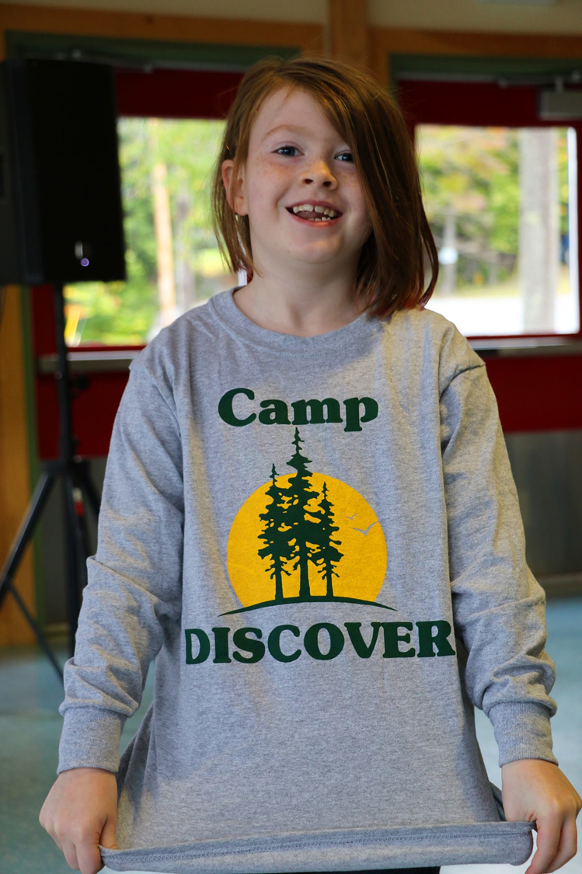
CAMP DISCOVER
A Program of Maine Hands & Voices
in partnership with the cued speech association of maine

Slide 2
H&V Mission/Vision Statement
Mission
Hands & Voices is a parent-driven organization that supports families with children who are deaf or hard of hearing without bias around communication modes or methodology.
Vision
We envision a world where children who are deaf and hard of hearing have every opportunity to achieve their full potential.
Motto
“What works for your child is what makes the choice right”
Notes:
Who are we, what are we all about?
The mission spelled out into the key points. I put a lot of emphasis on the first bullet: three major points
Parent-driven…one of the only orgs out there where the majority (51%) of Board members are parents it is part of our fabric and a chapter requirement, we parents bring our personal experience to help others.
We believe that there is no one communication choice that will work for all children who are deaf or hard of hearing. We think families need access to good information that’s free from a sponsoring agenda or ideology.
We also believe in collaboration; that there must be relationship building with the professionals who are so dedicated to our children and families. As parents, we can have support groups and talk about what’s good and what’s not so good, but in order to move forward we need to bridge those relationships and involve and support the professionals in our system of care that that support us and our children.
Then the motto…We believe…

Slide 3
Why Families Need Support
95% of all children who are deaf or hard of hearing are born into hearing families ( Mitchell & Karchmer 2004)
90% of these families have no background in deafness or connections to the deaf community (Center for Demographic Studies 1984)
“The key to a successful integration of hearing loss into a family is the degree to which parents are able to integrate hearing loss into their lives” (D. Luterman, 2006)

Slide 4
WHO needs to be unbiased?....

Slide 6
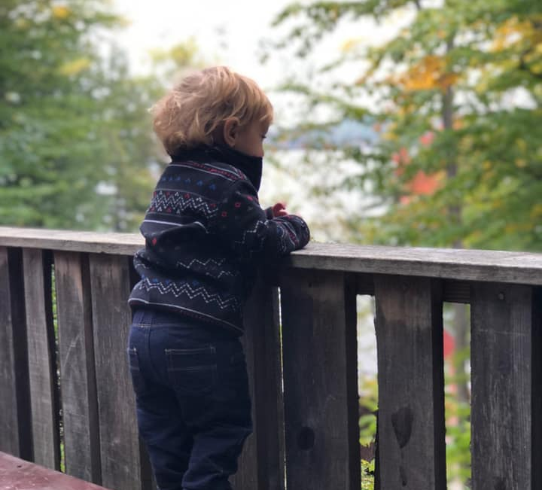
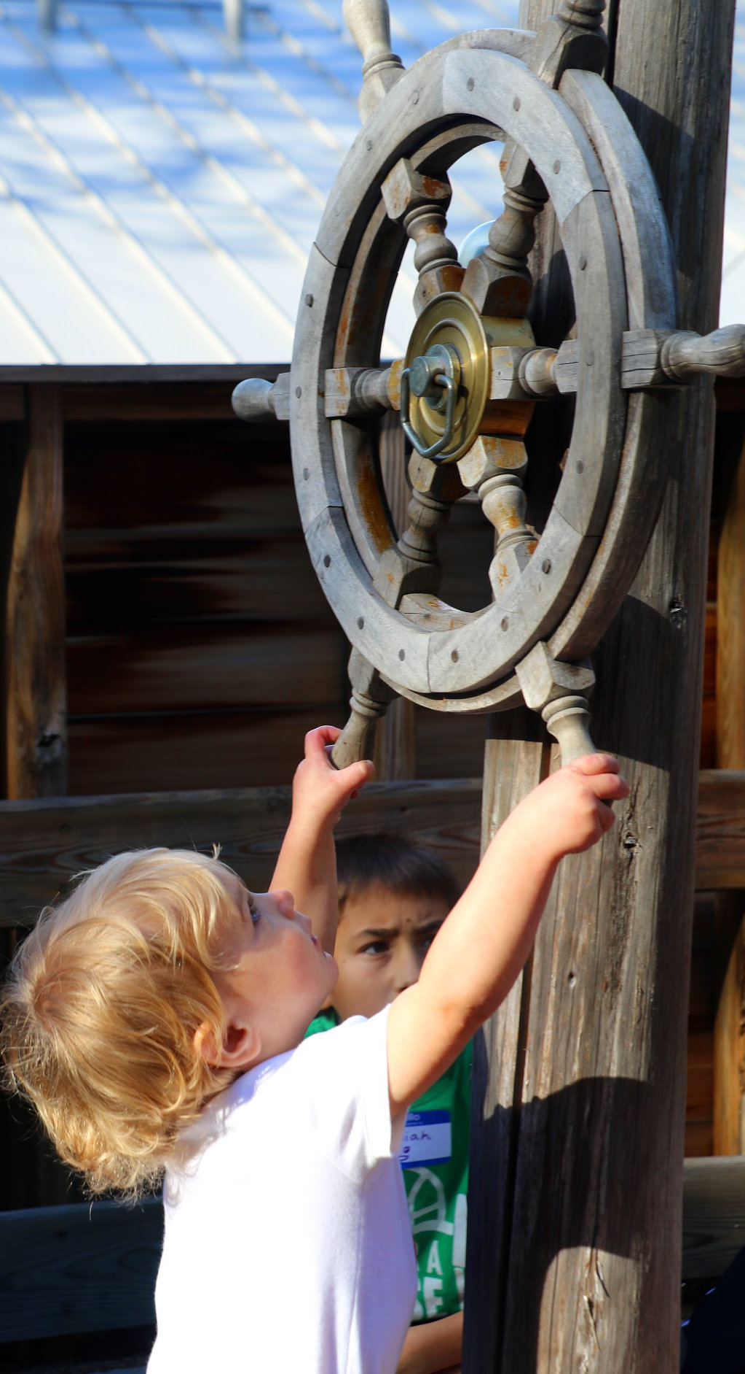
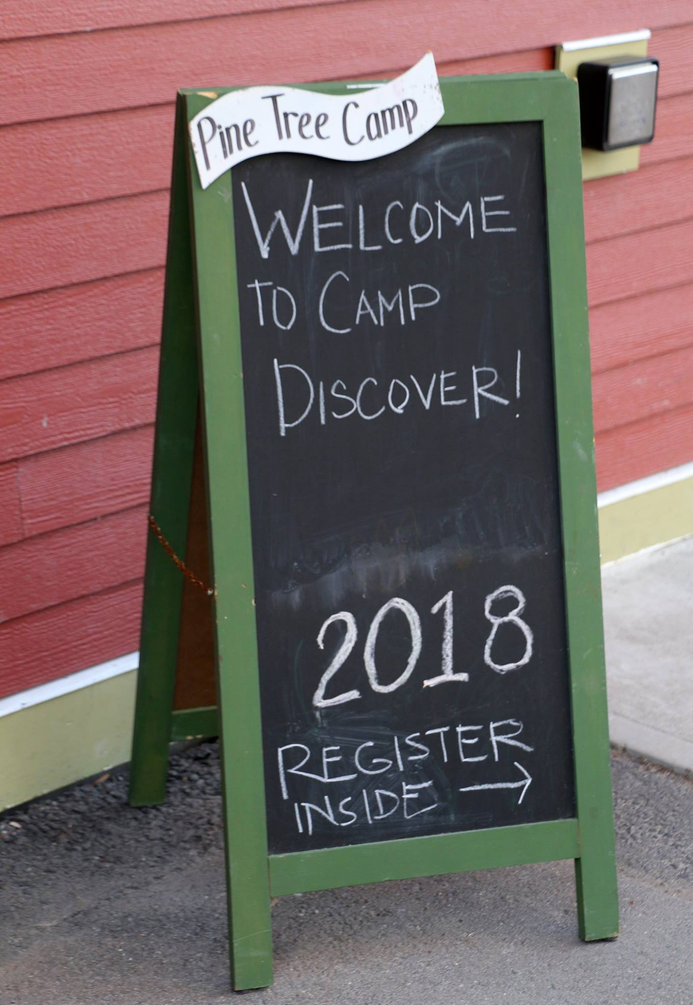
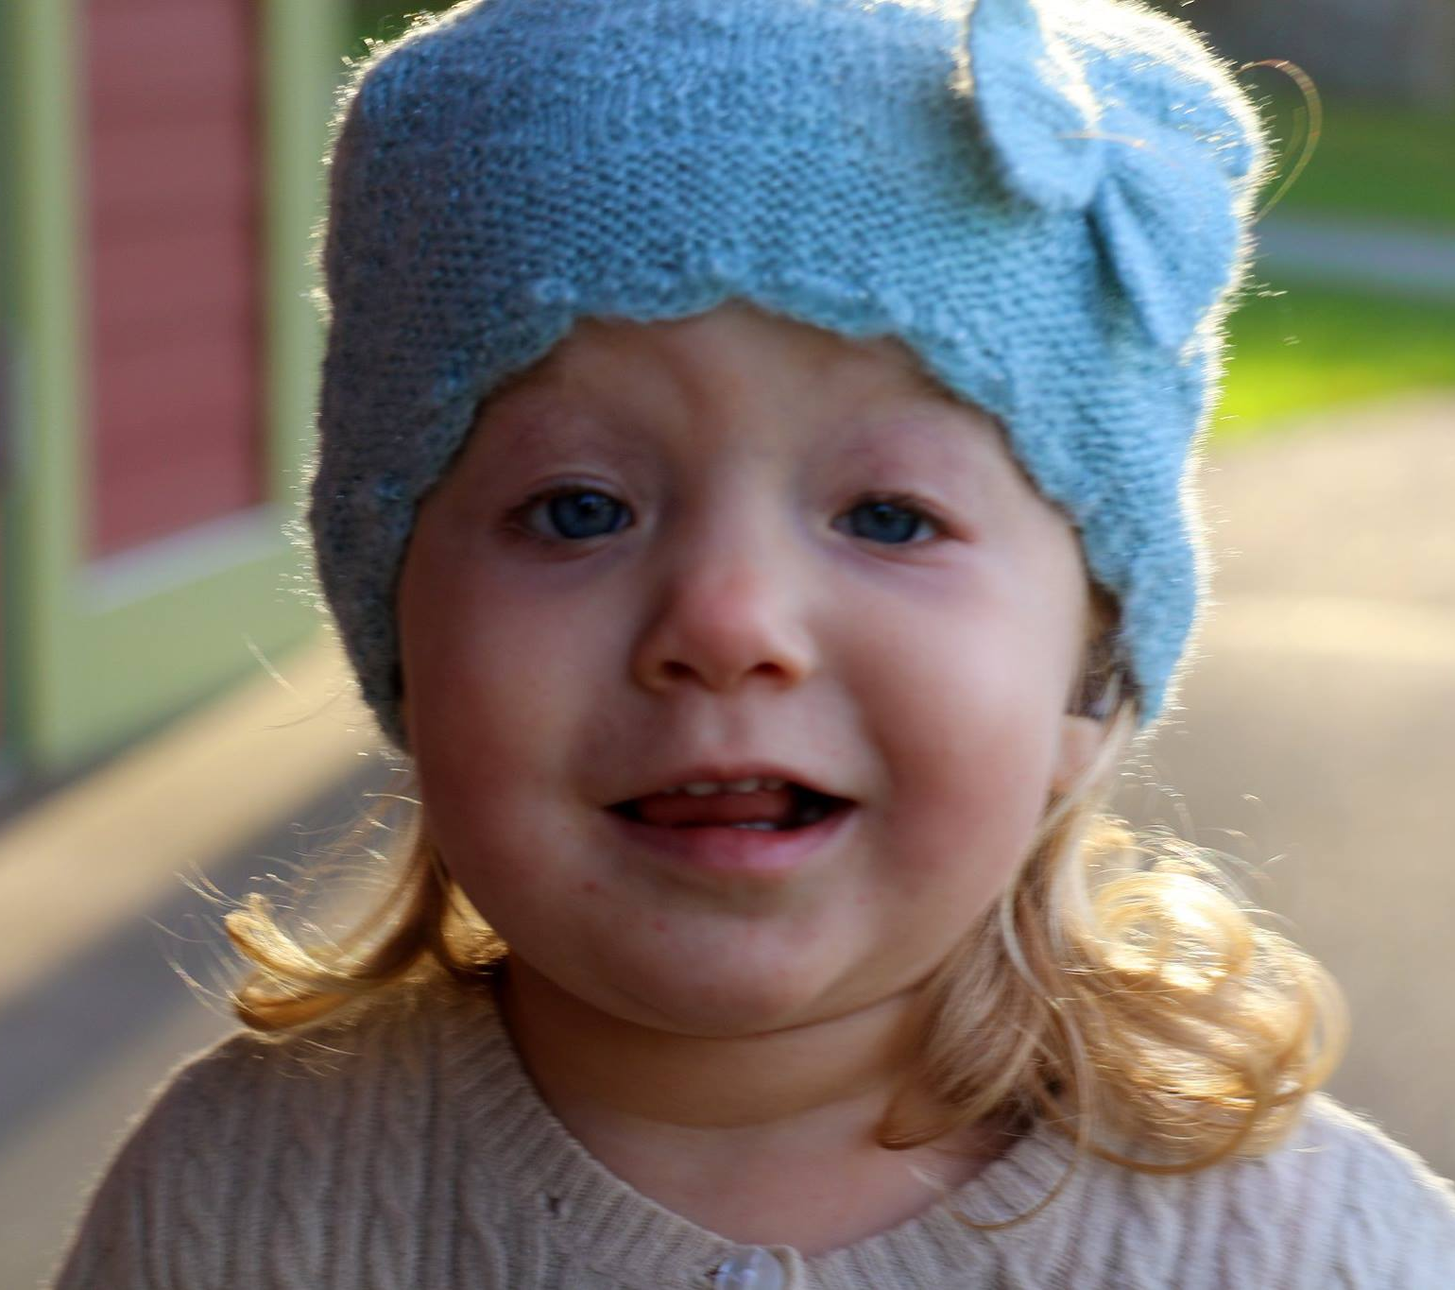
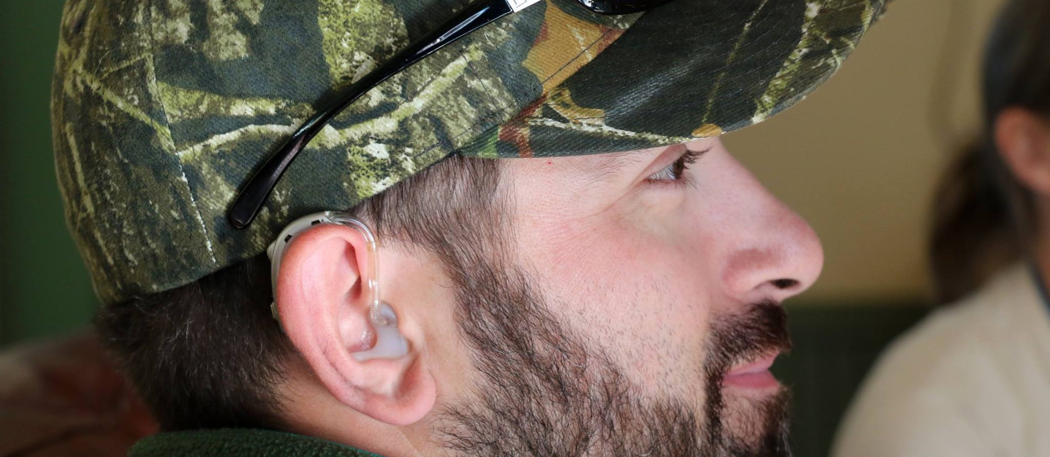

Slide 7
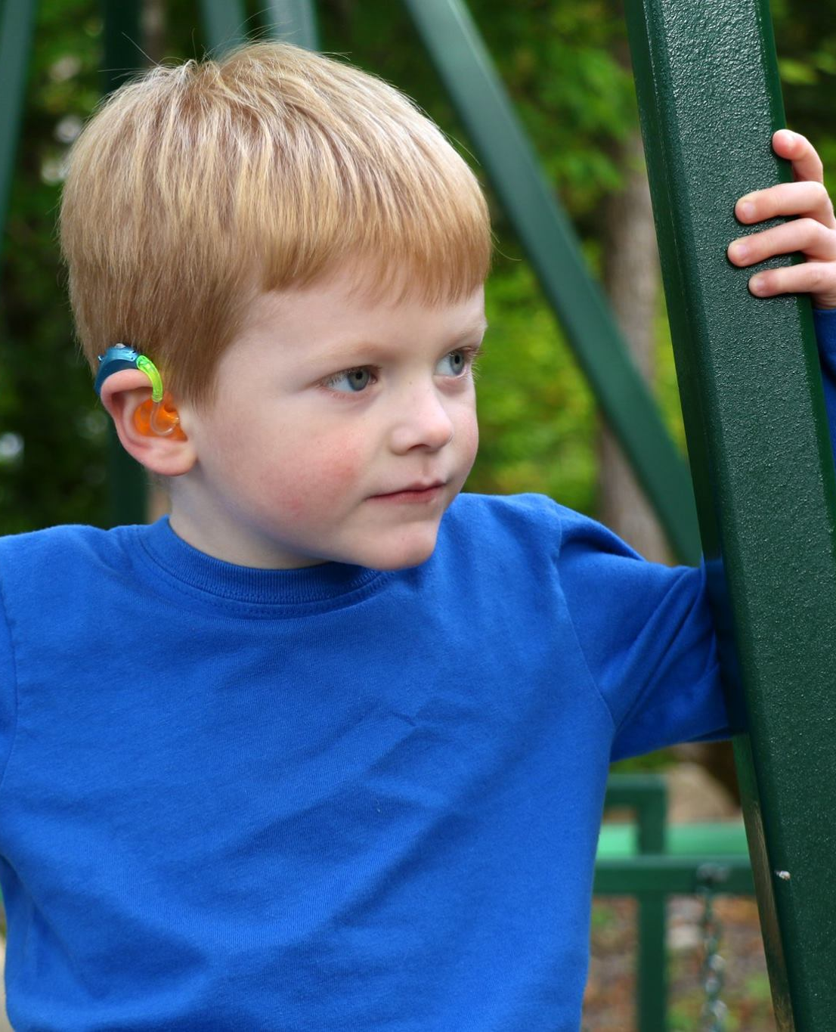
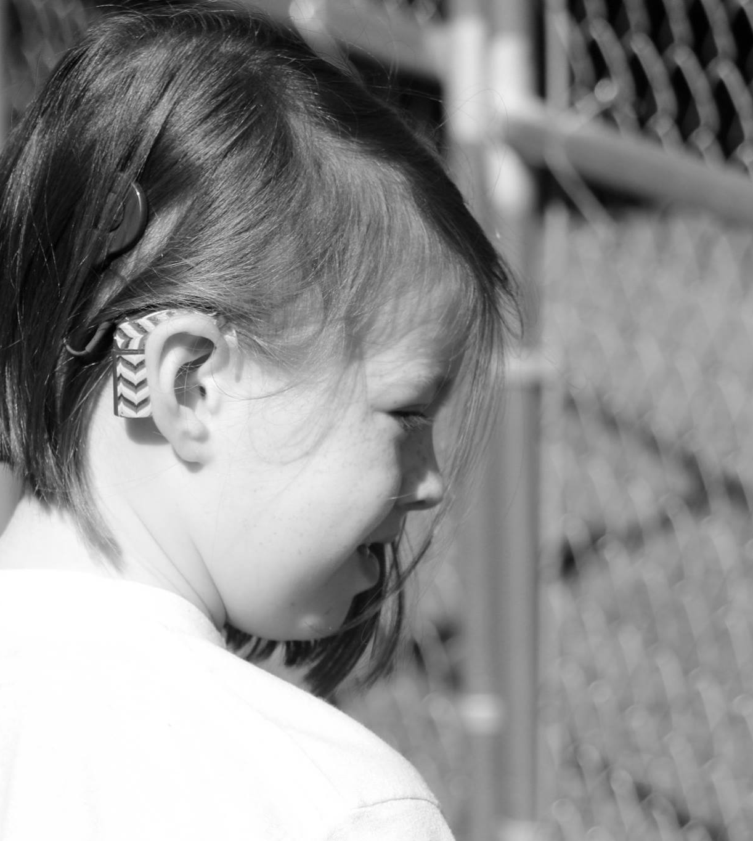
LANGUAGES & MODALITIES: Listening & Spoken Language

Slide 8
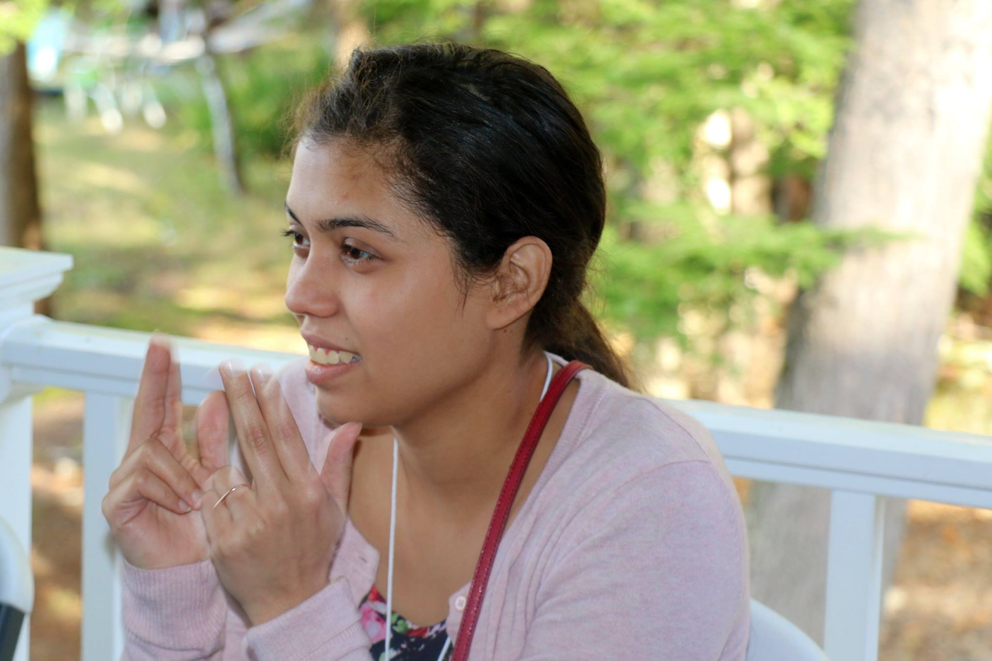
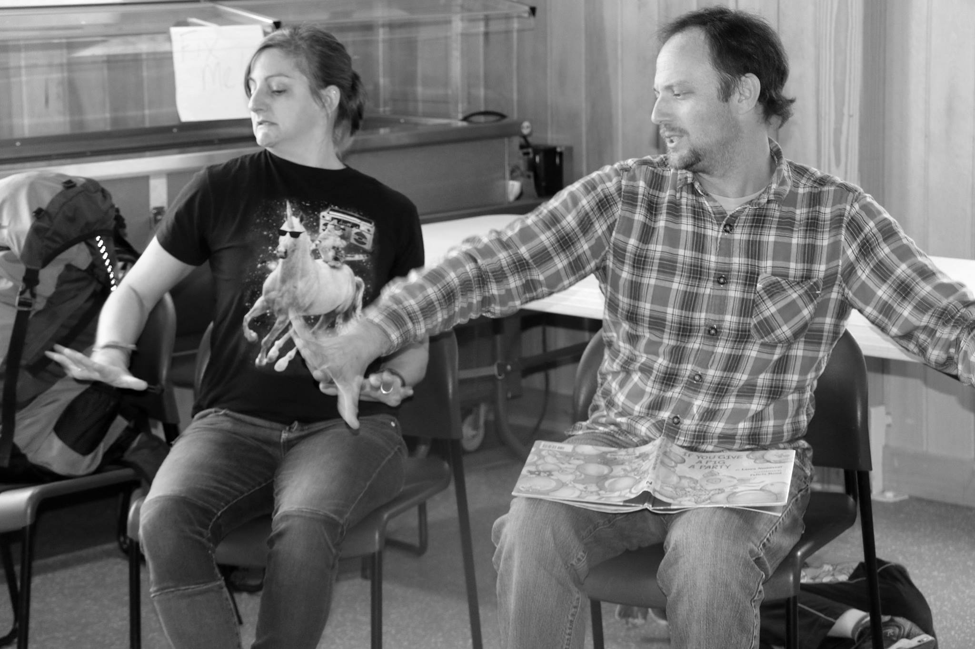
LANGUAGES & MODALITIES: American Sign Language

Slide 9
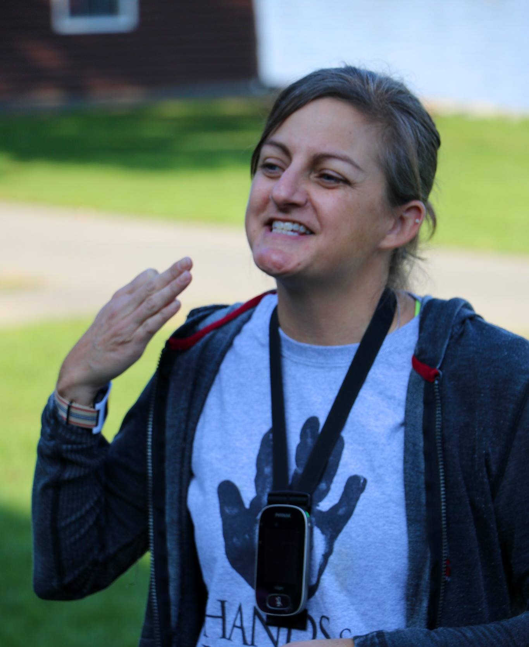
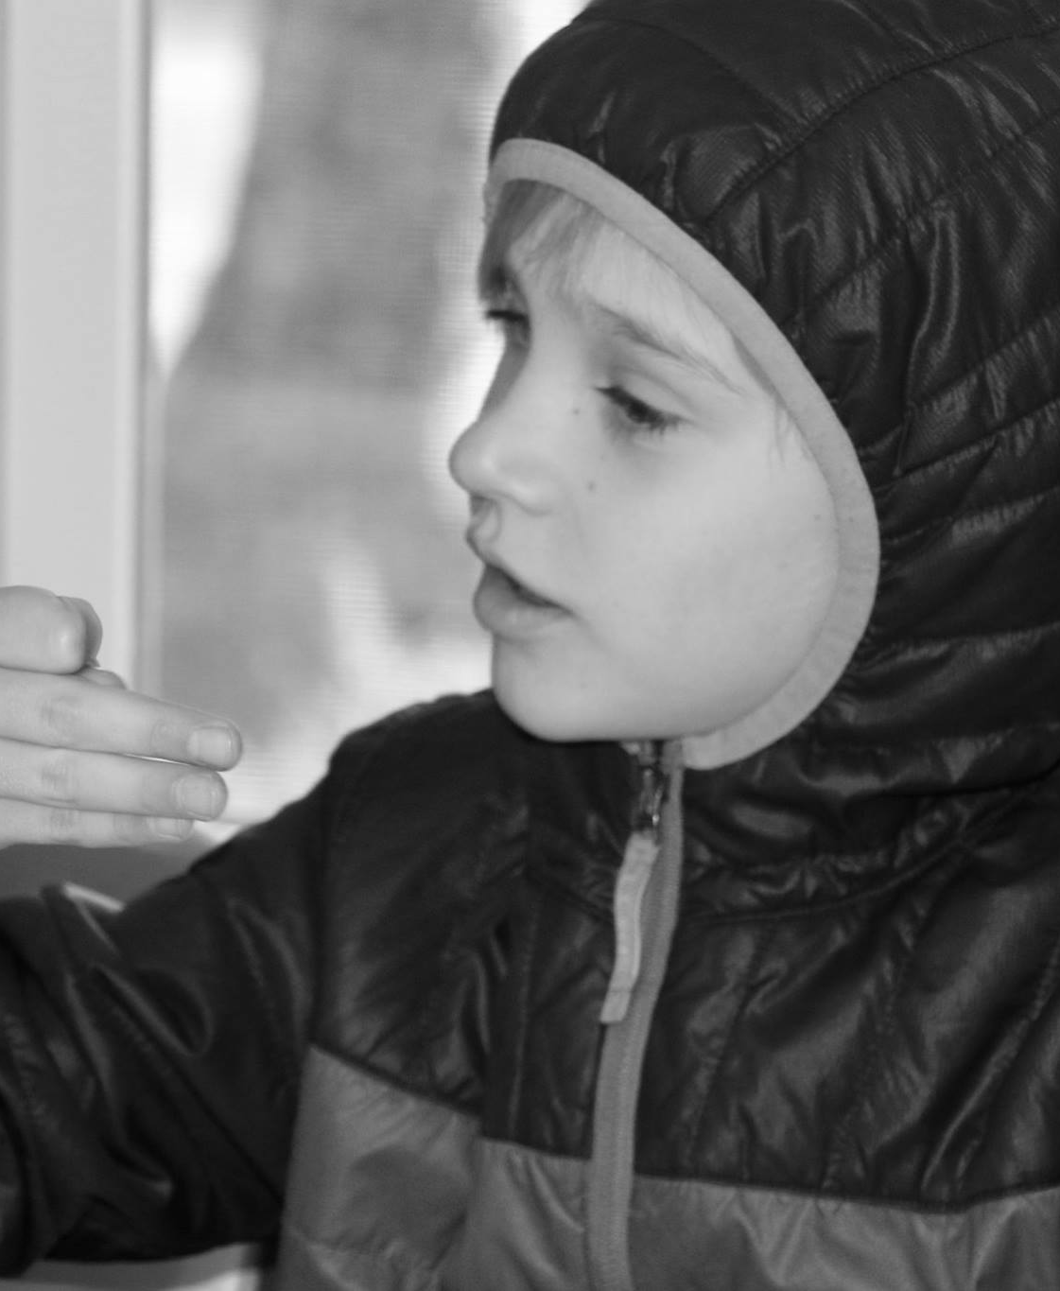
LANGUAGES & MODALITIES: Cued Speech/Cued Language

Slide 10
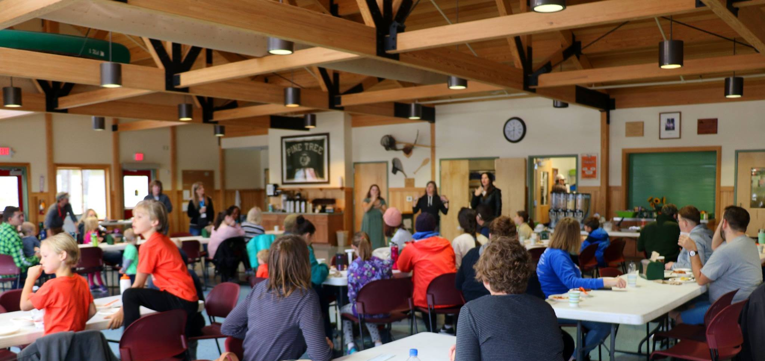
ASL Interpreters & Cued Langauge Transliterators

Slide 11
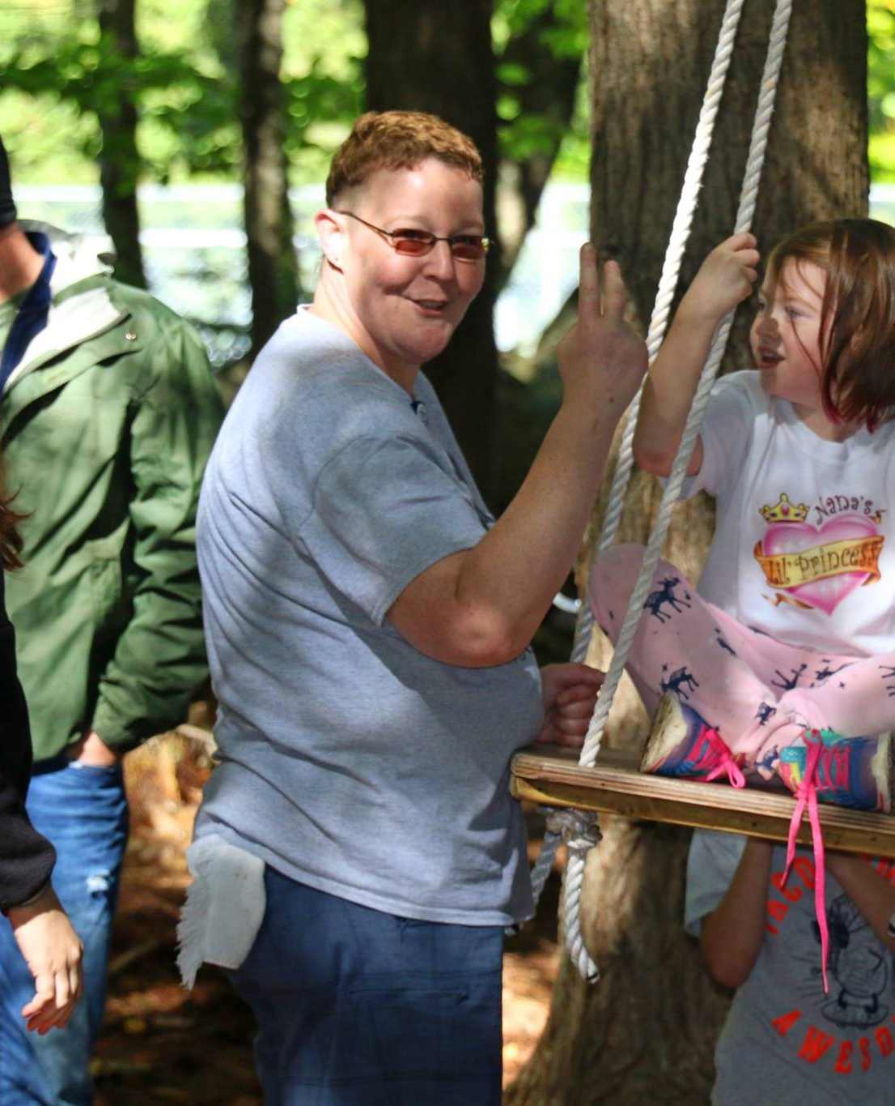
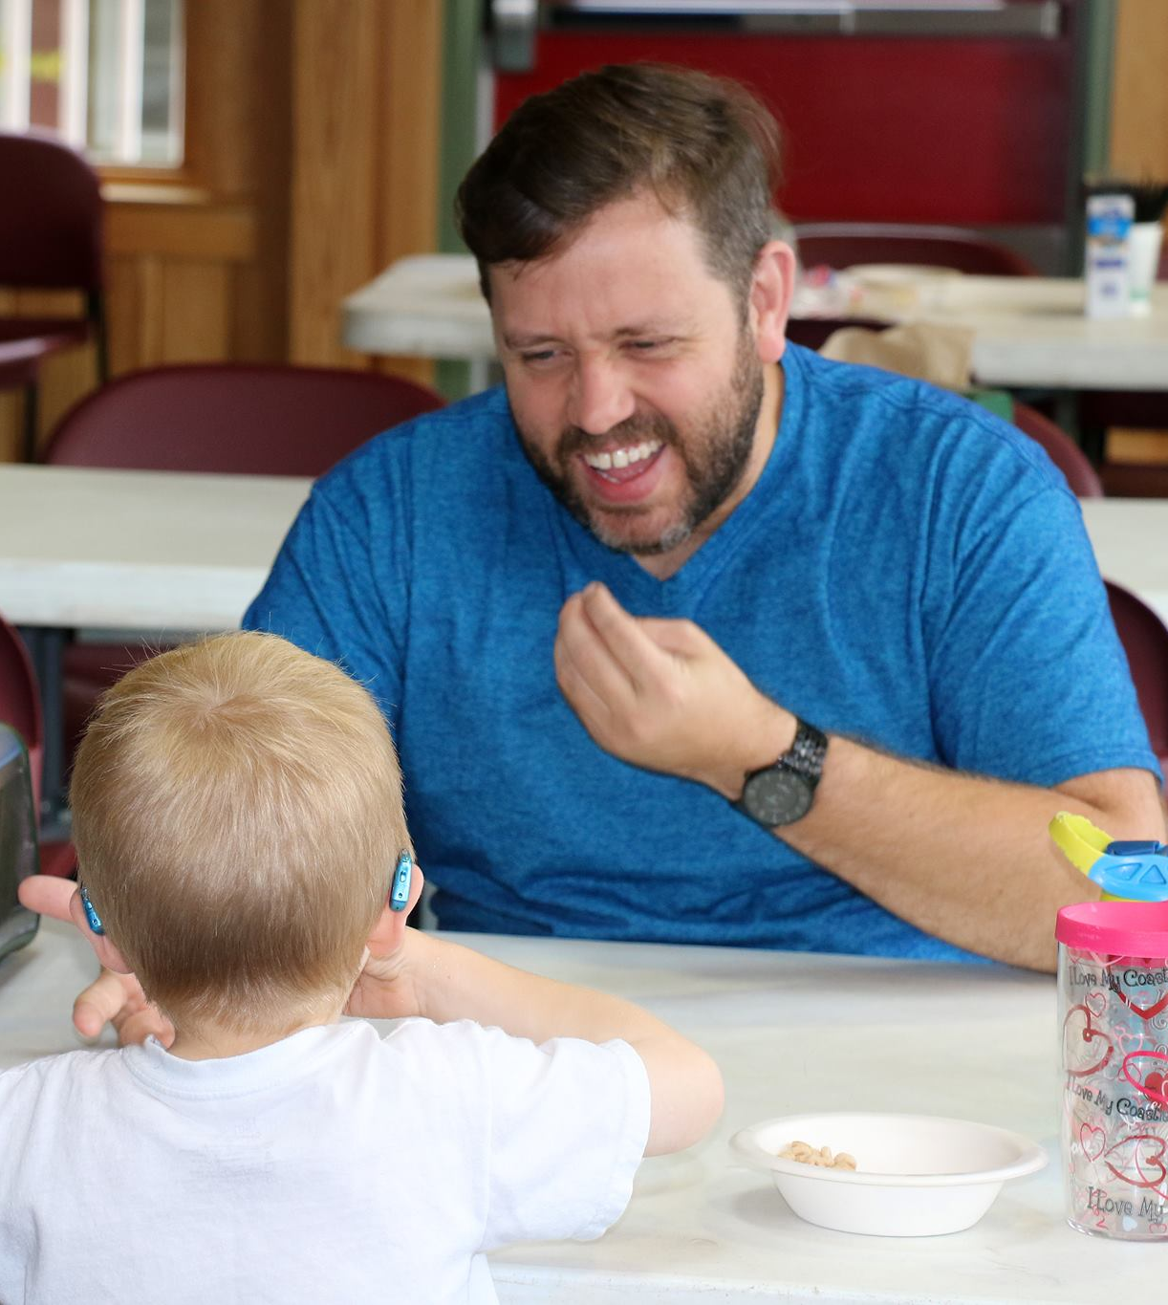
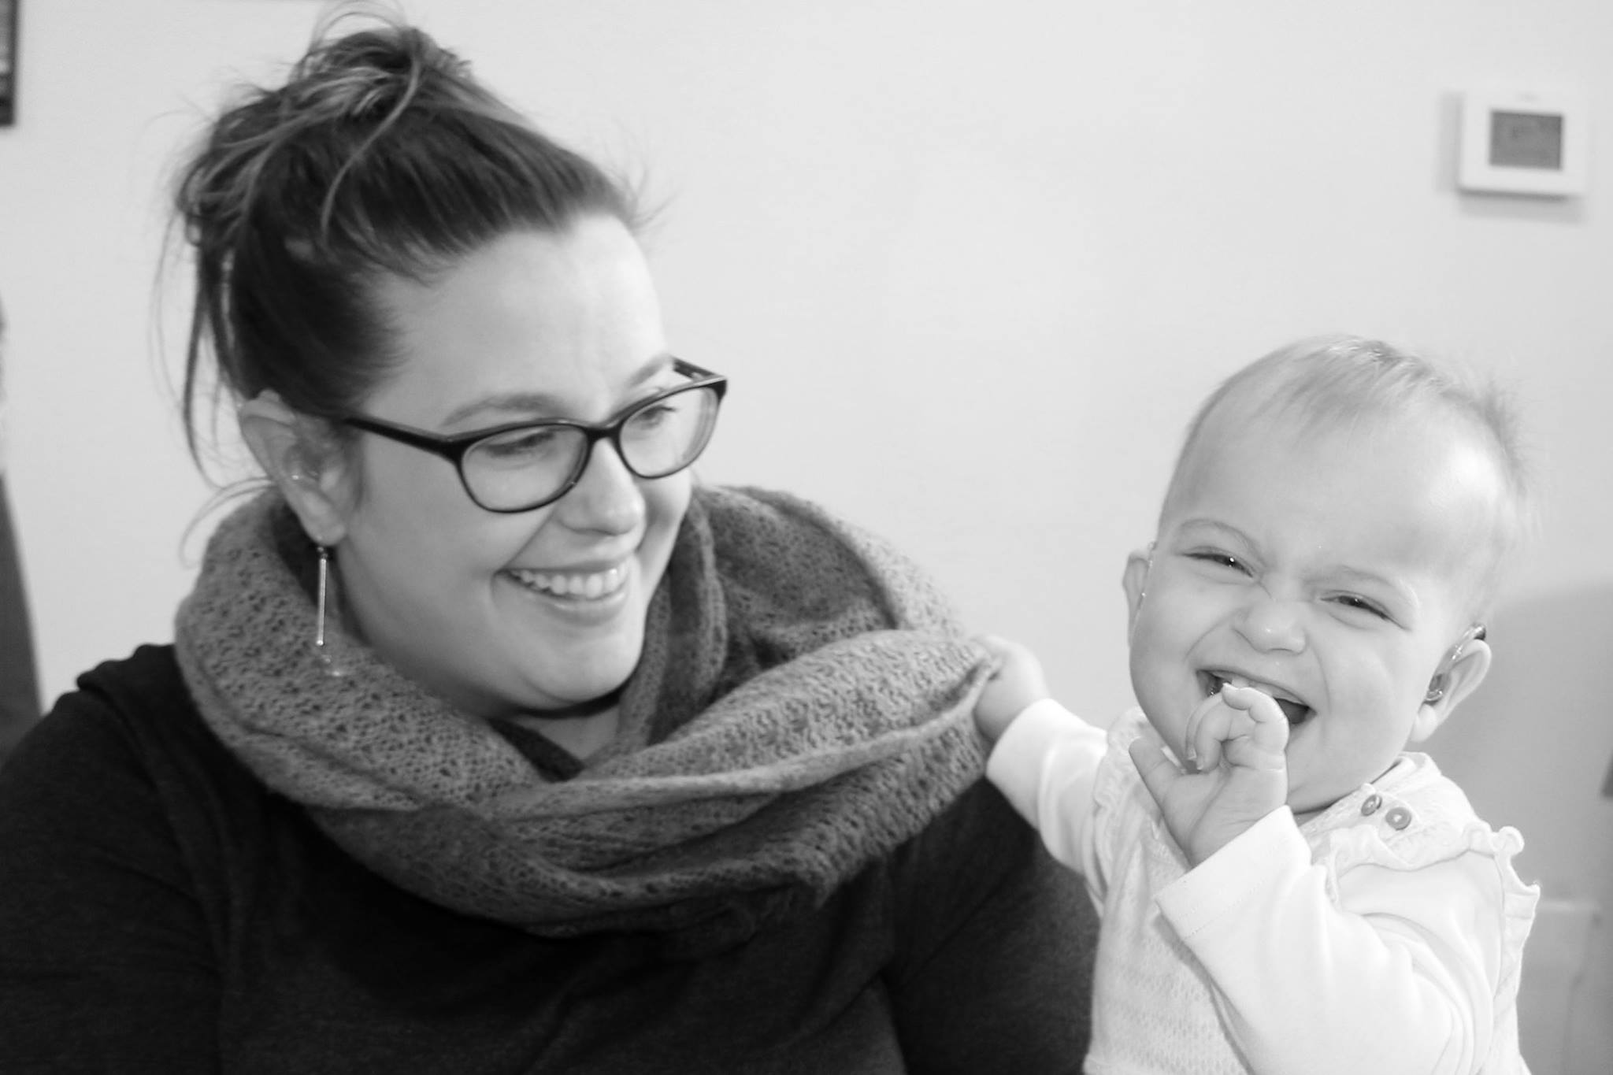
D/deaf & Hard of Hearing Role Models

Slide 12
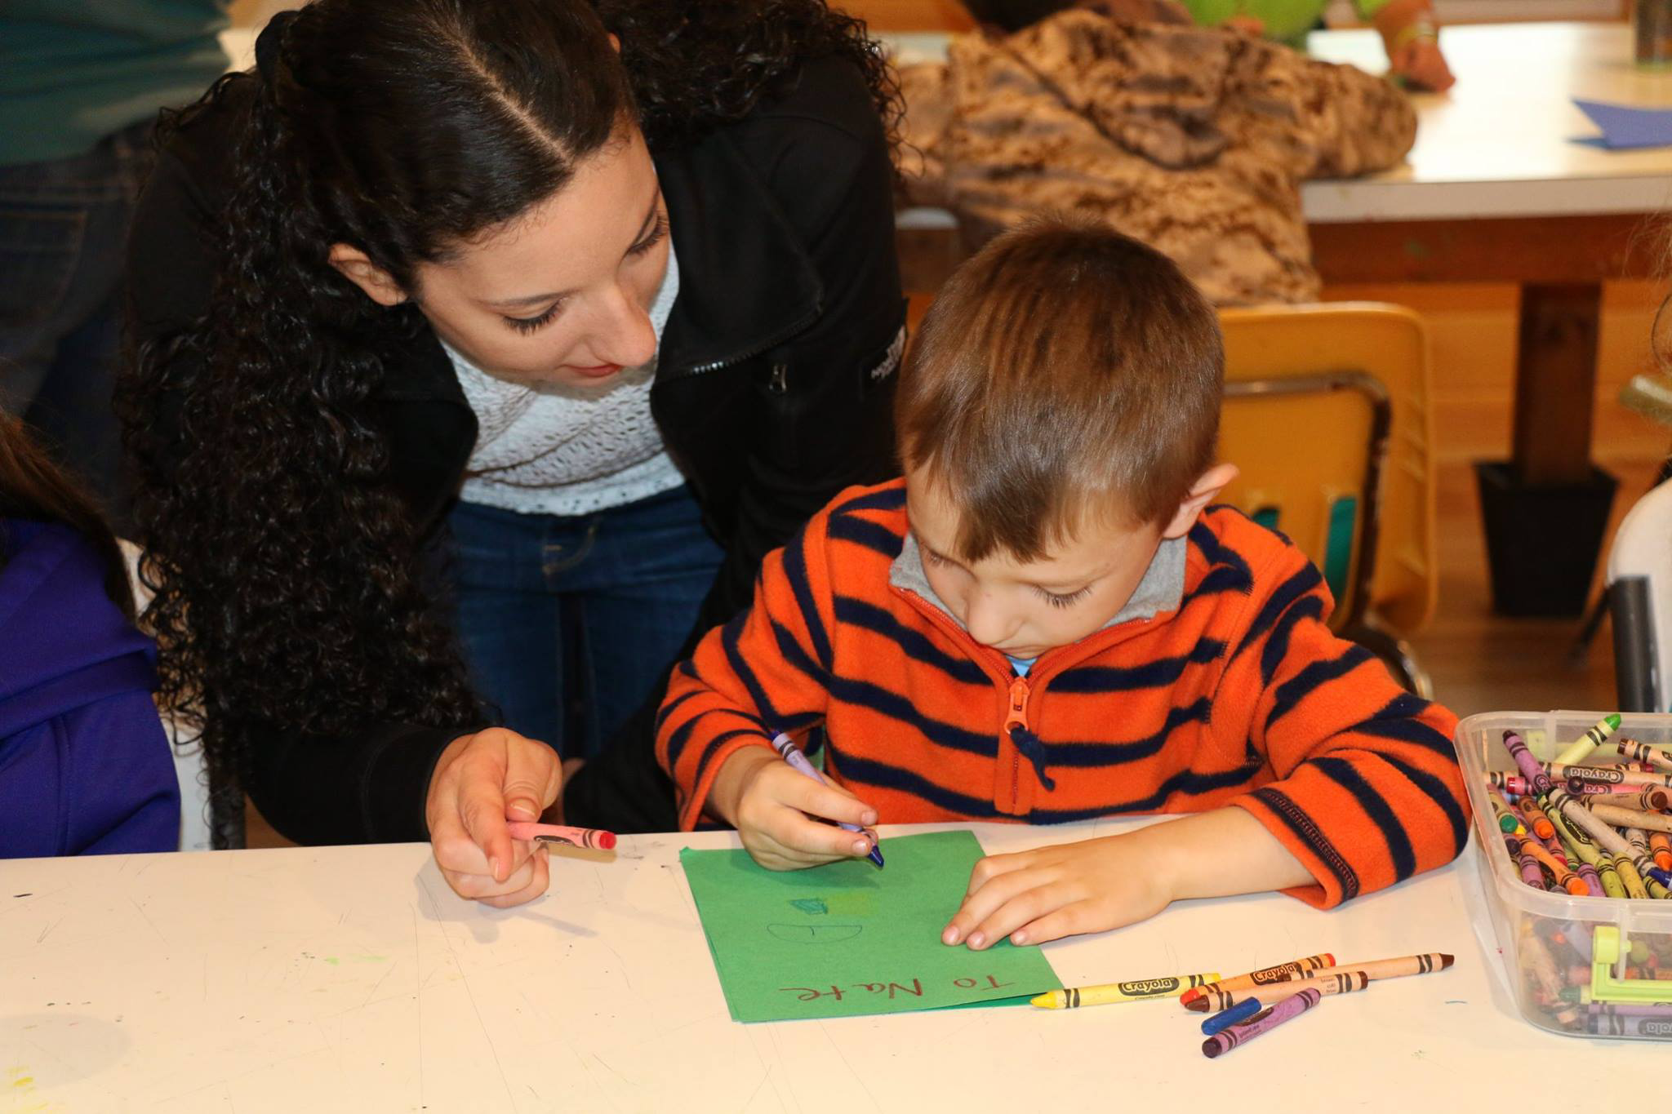
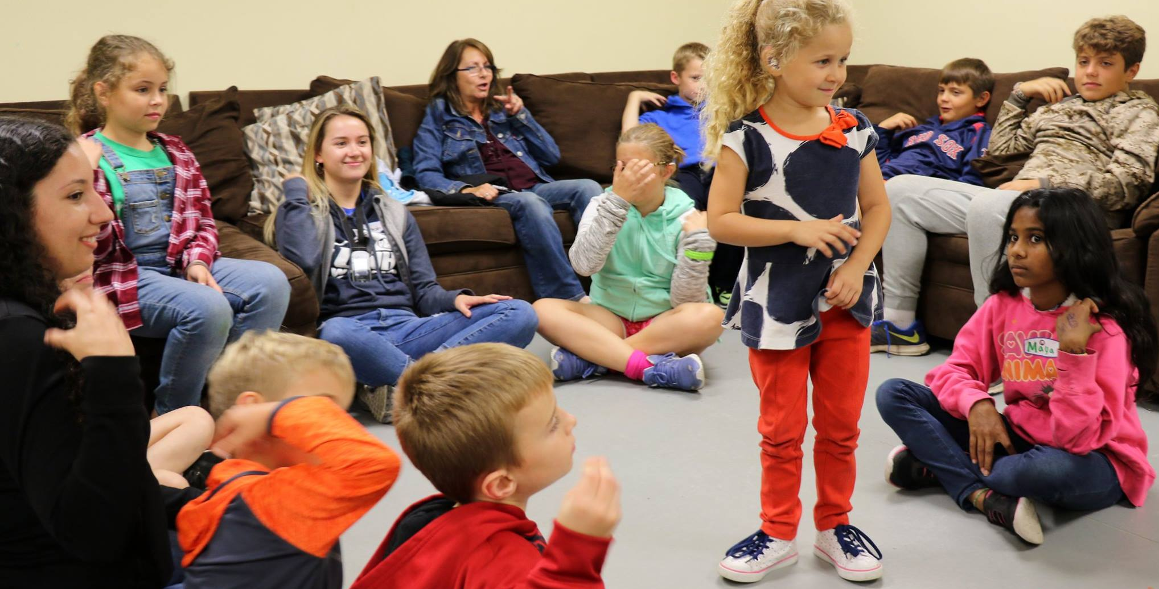
Student Interns

Slide 13
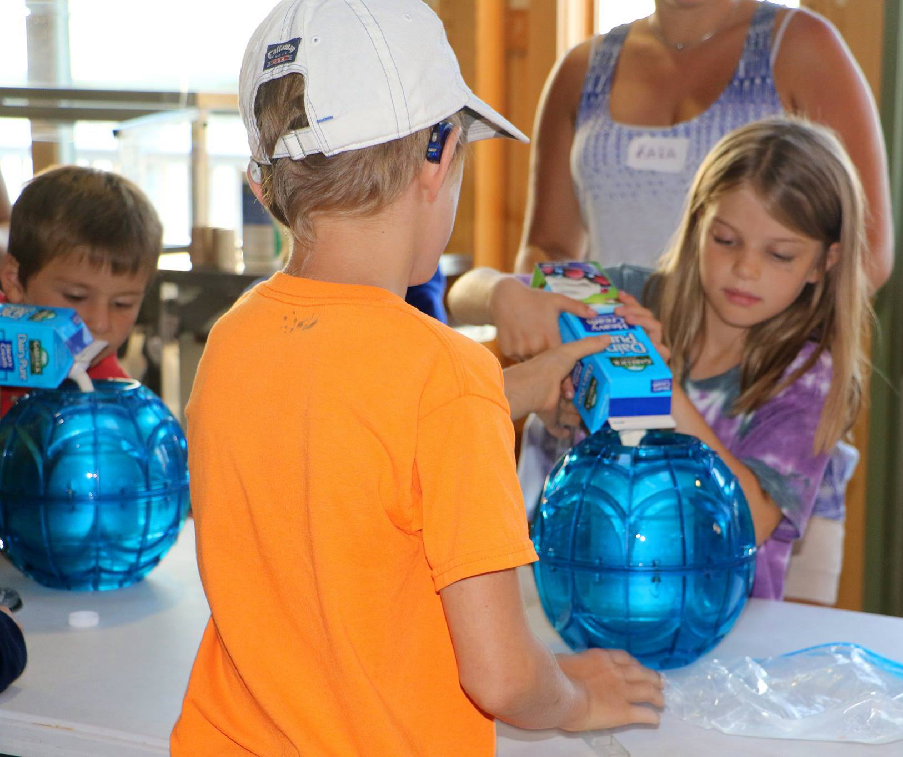
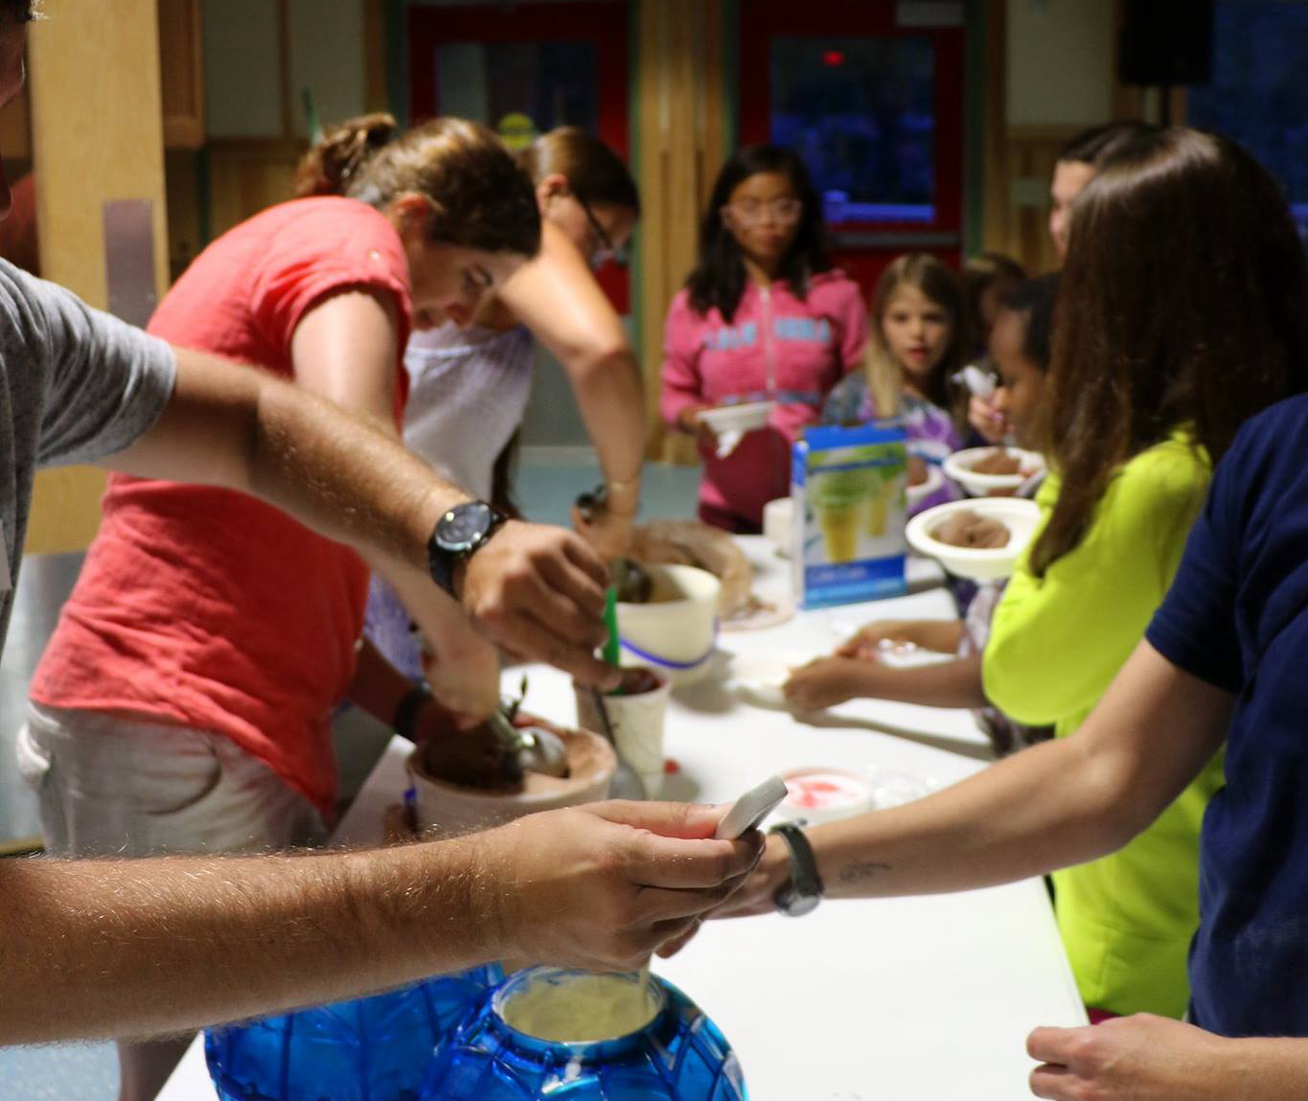
Ice Cream Social

Slide 14
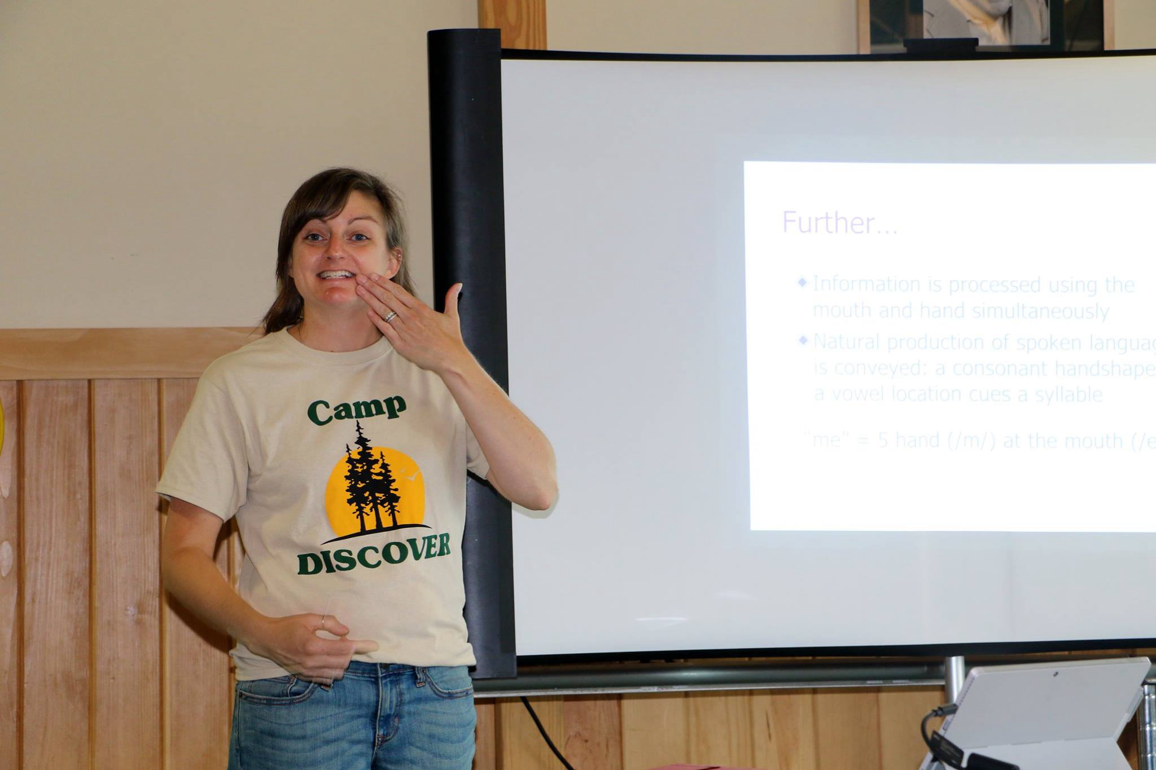
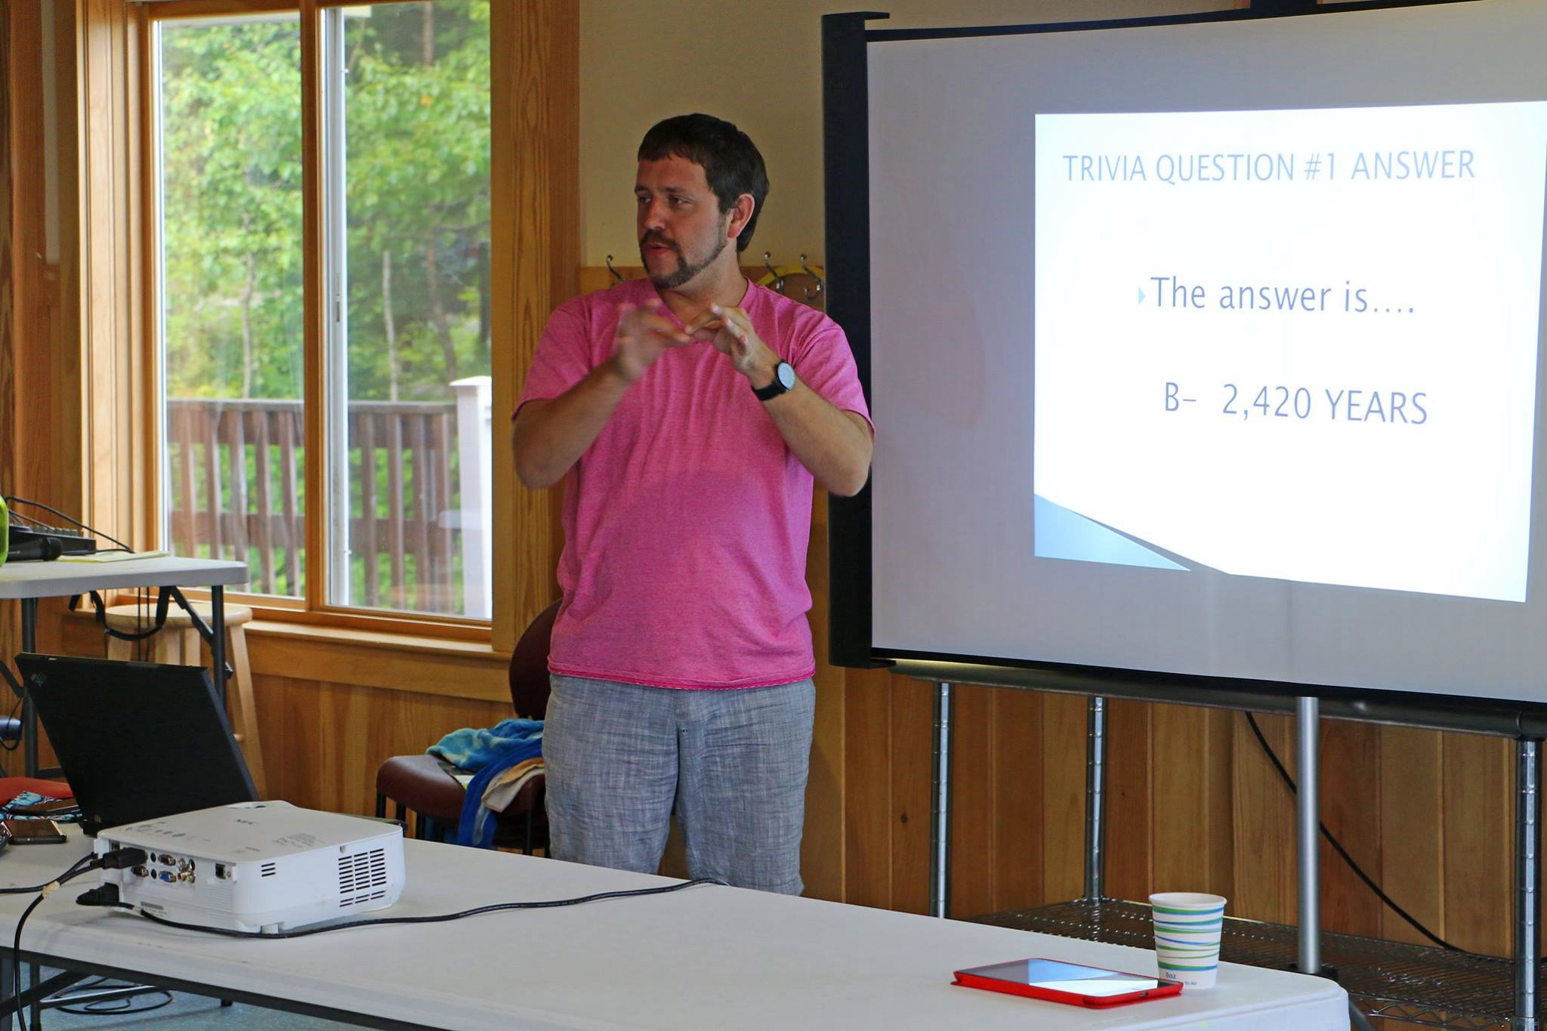
Presentation of Languages & Modalities

Slide 15
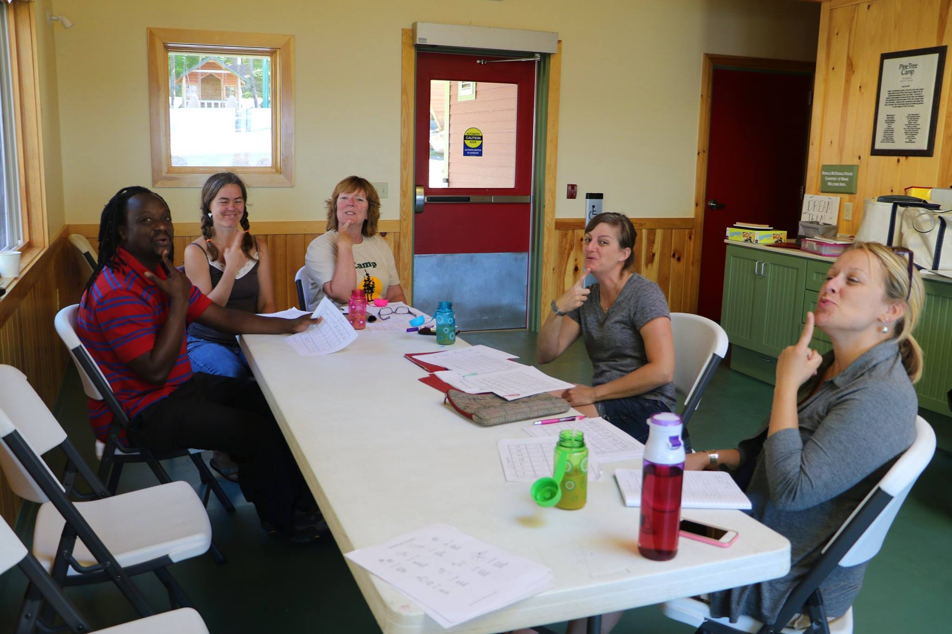
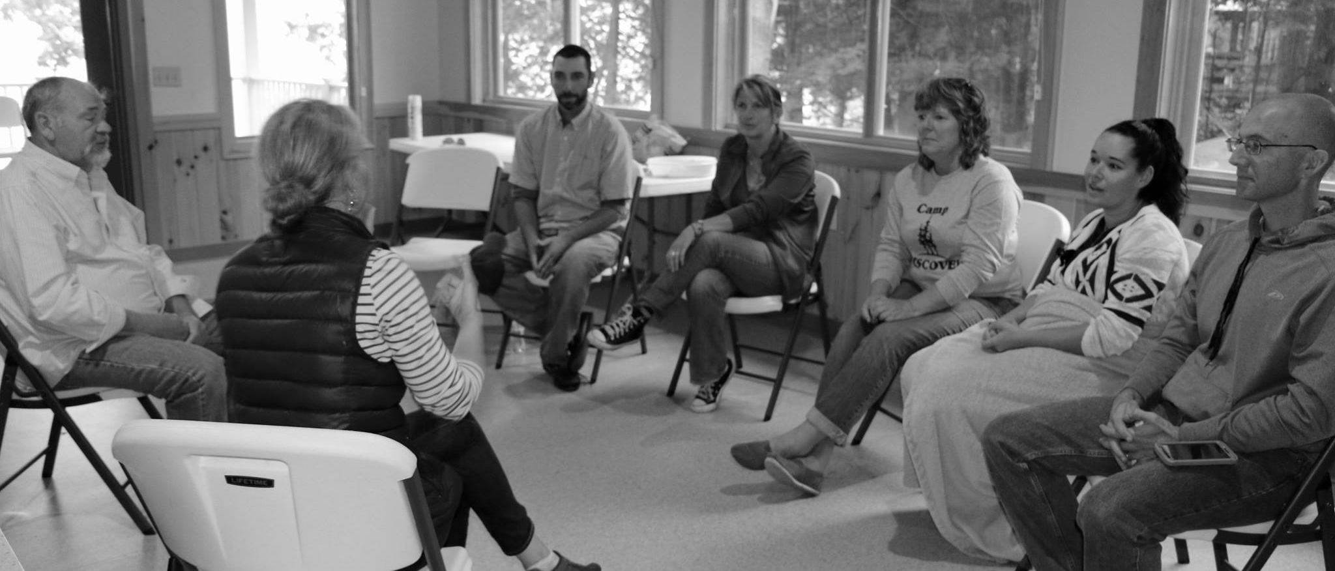
Adult Classes: LSL, ASL, CS/CL

Slide 16
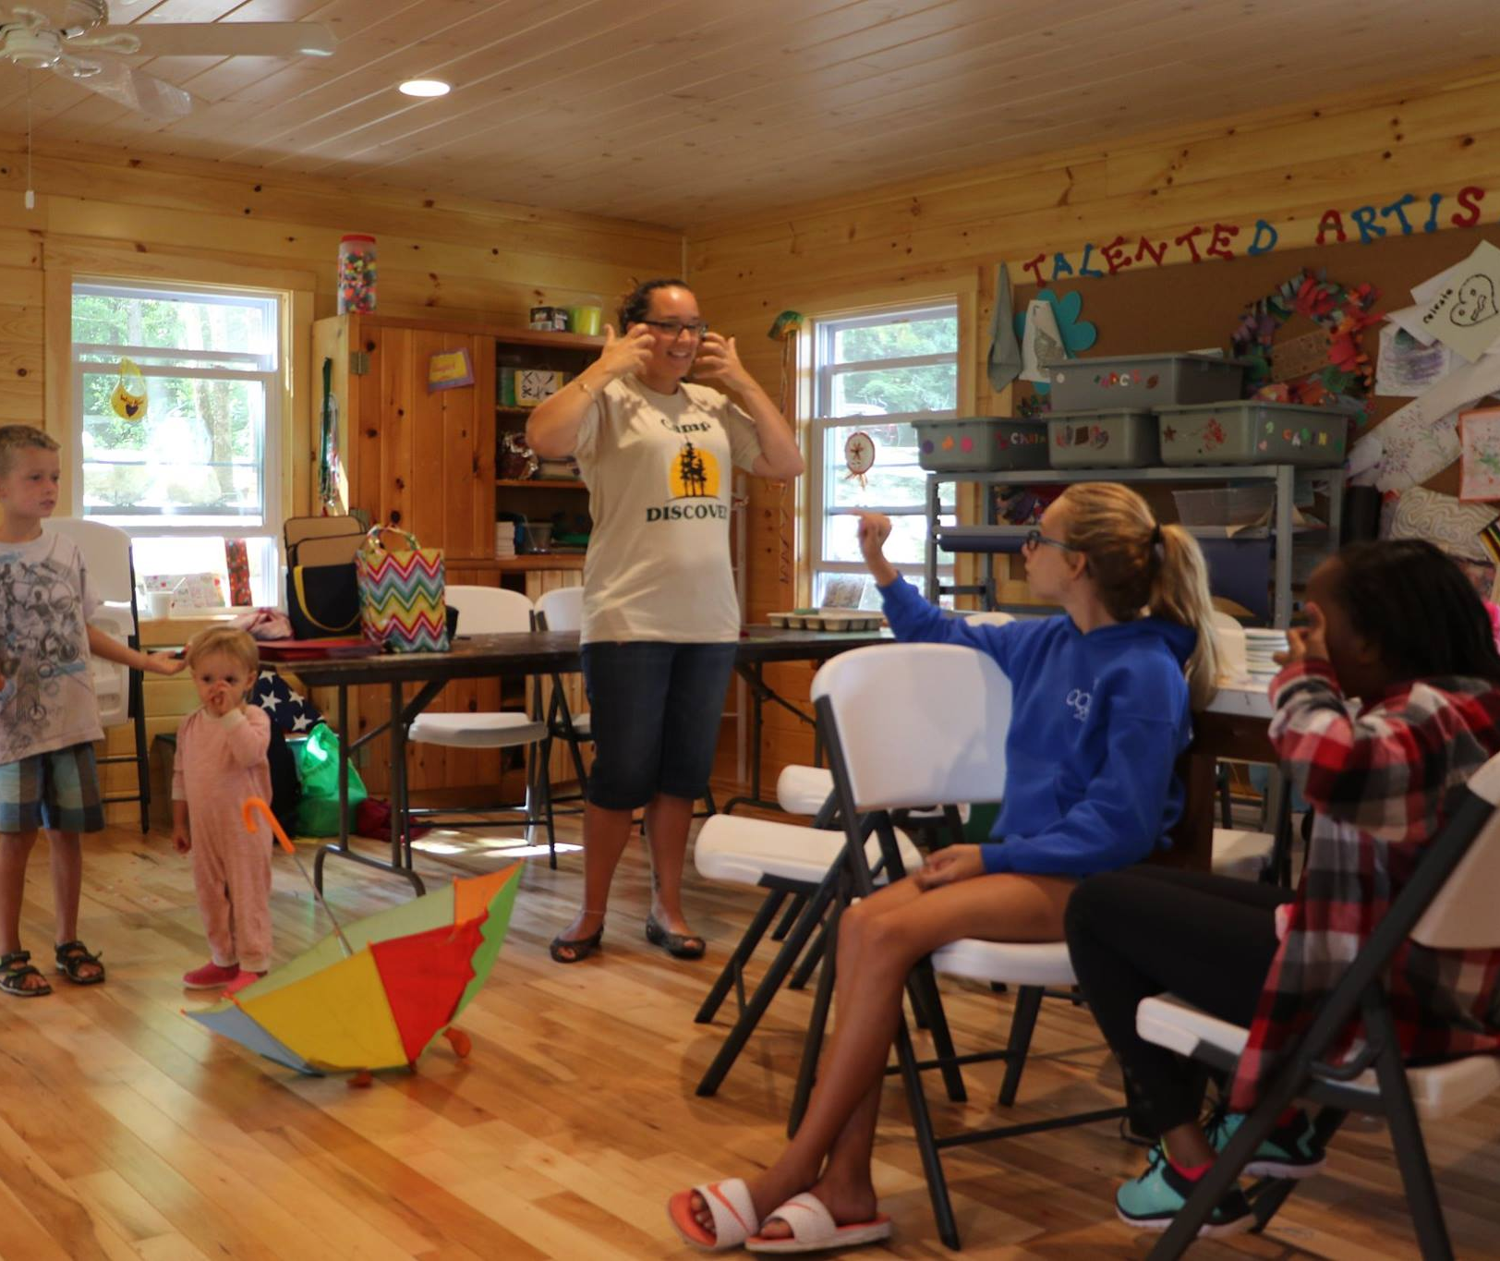
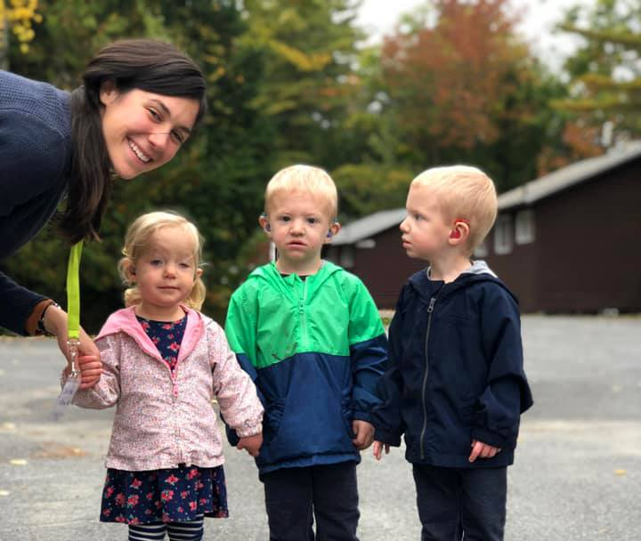
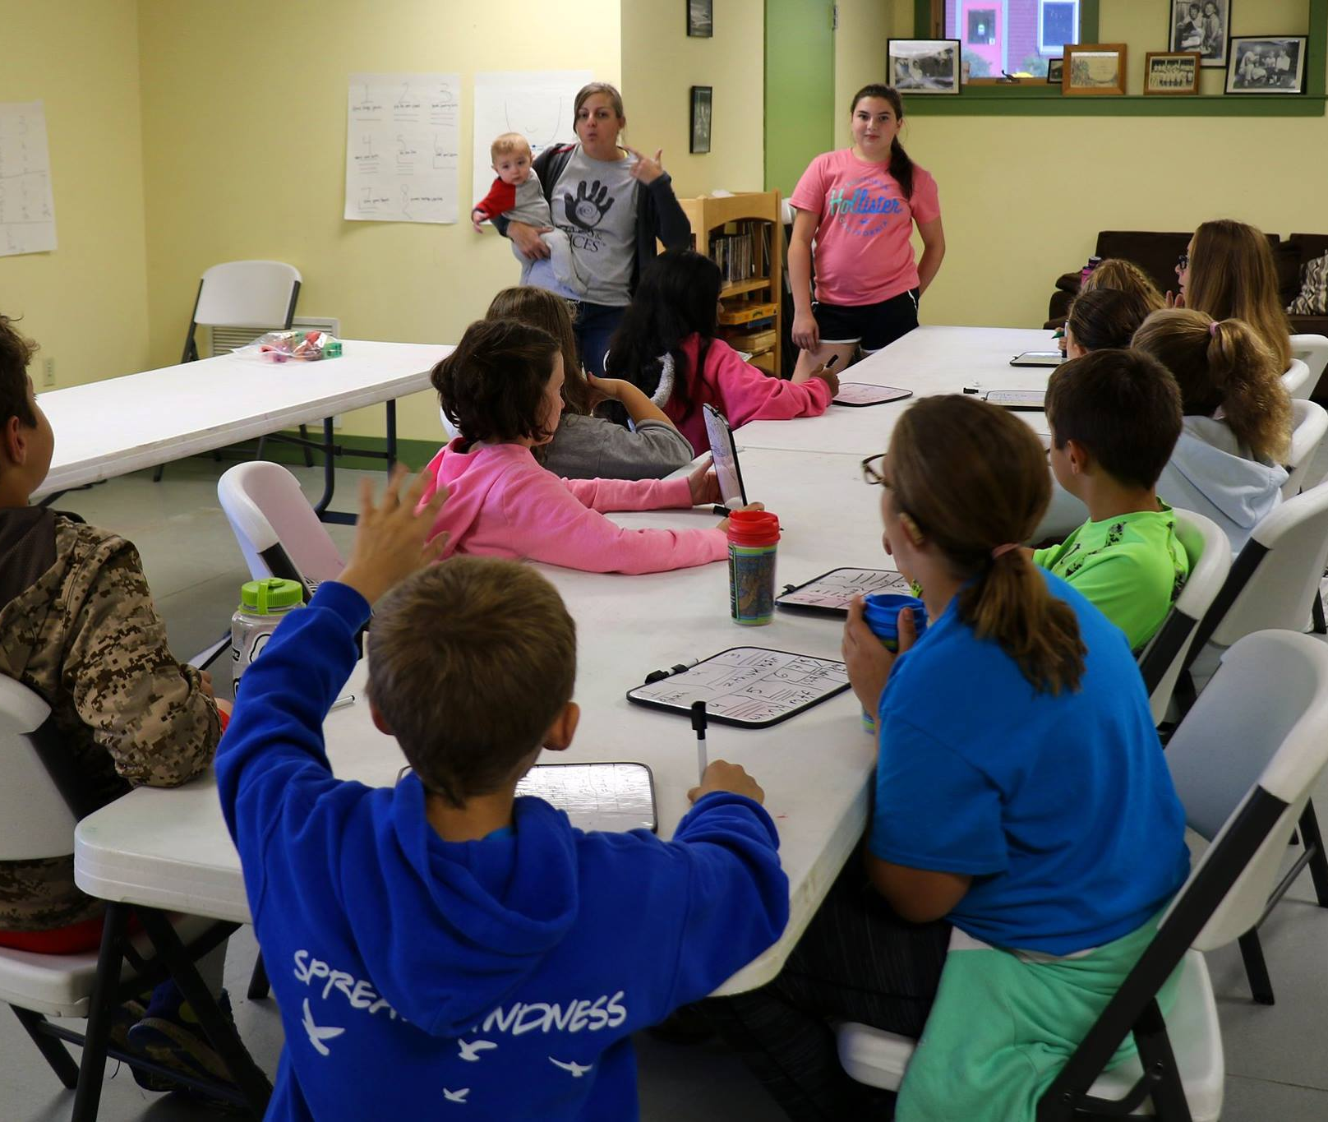
Kids’ Classes: ASL, CS

Slide 17
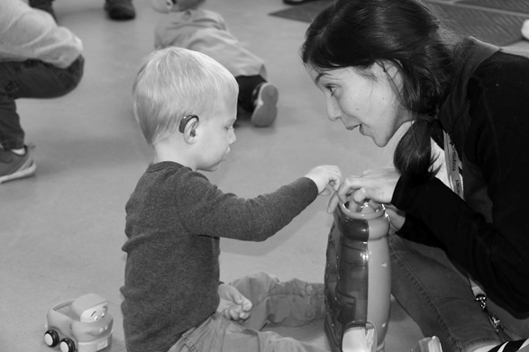
Modality Specific Speech-Language Therapy

Slide 18
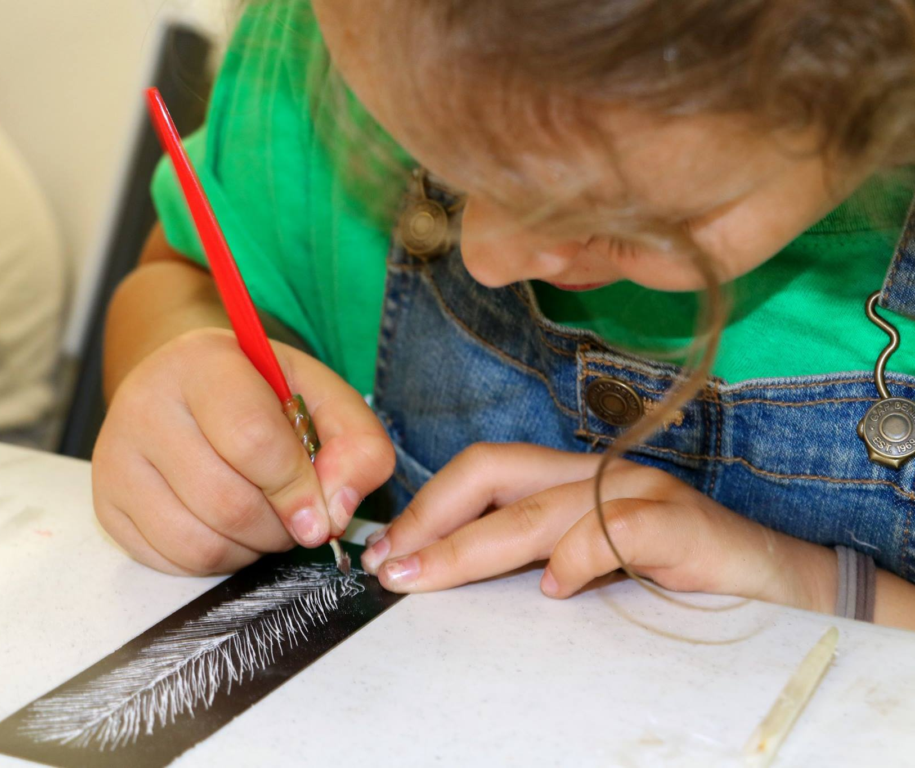
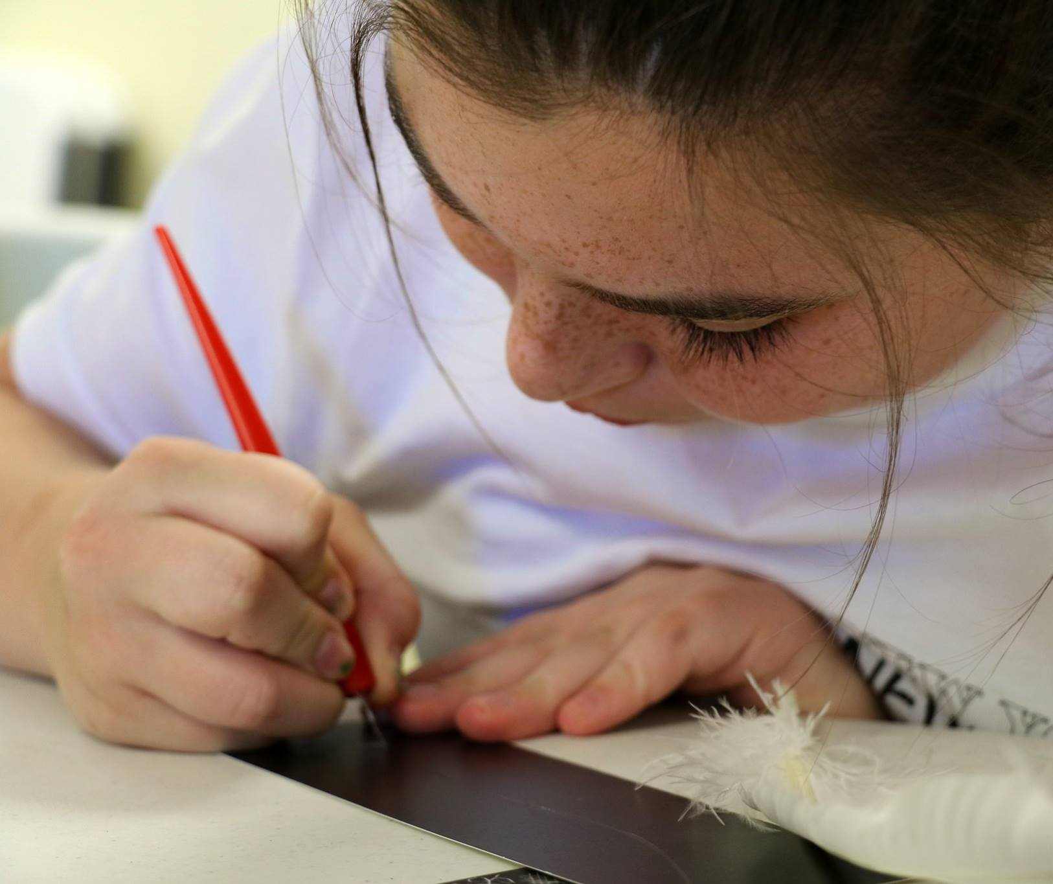
Art Lessons

Slide 19
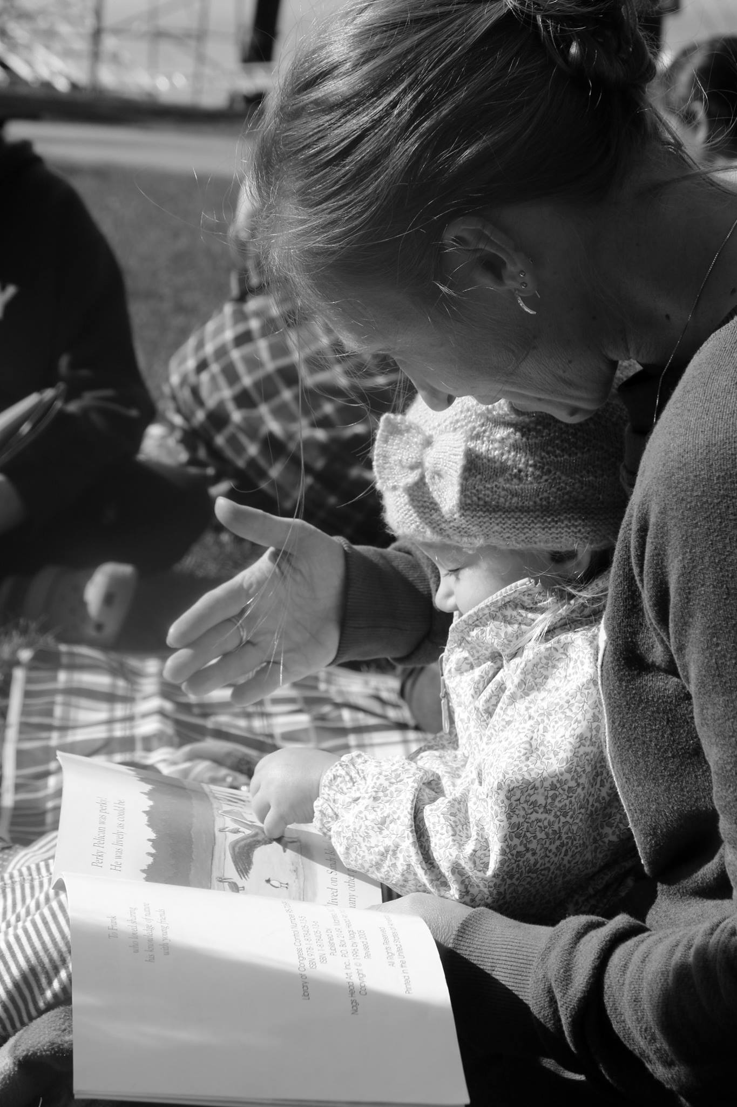
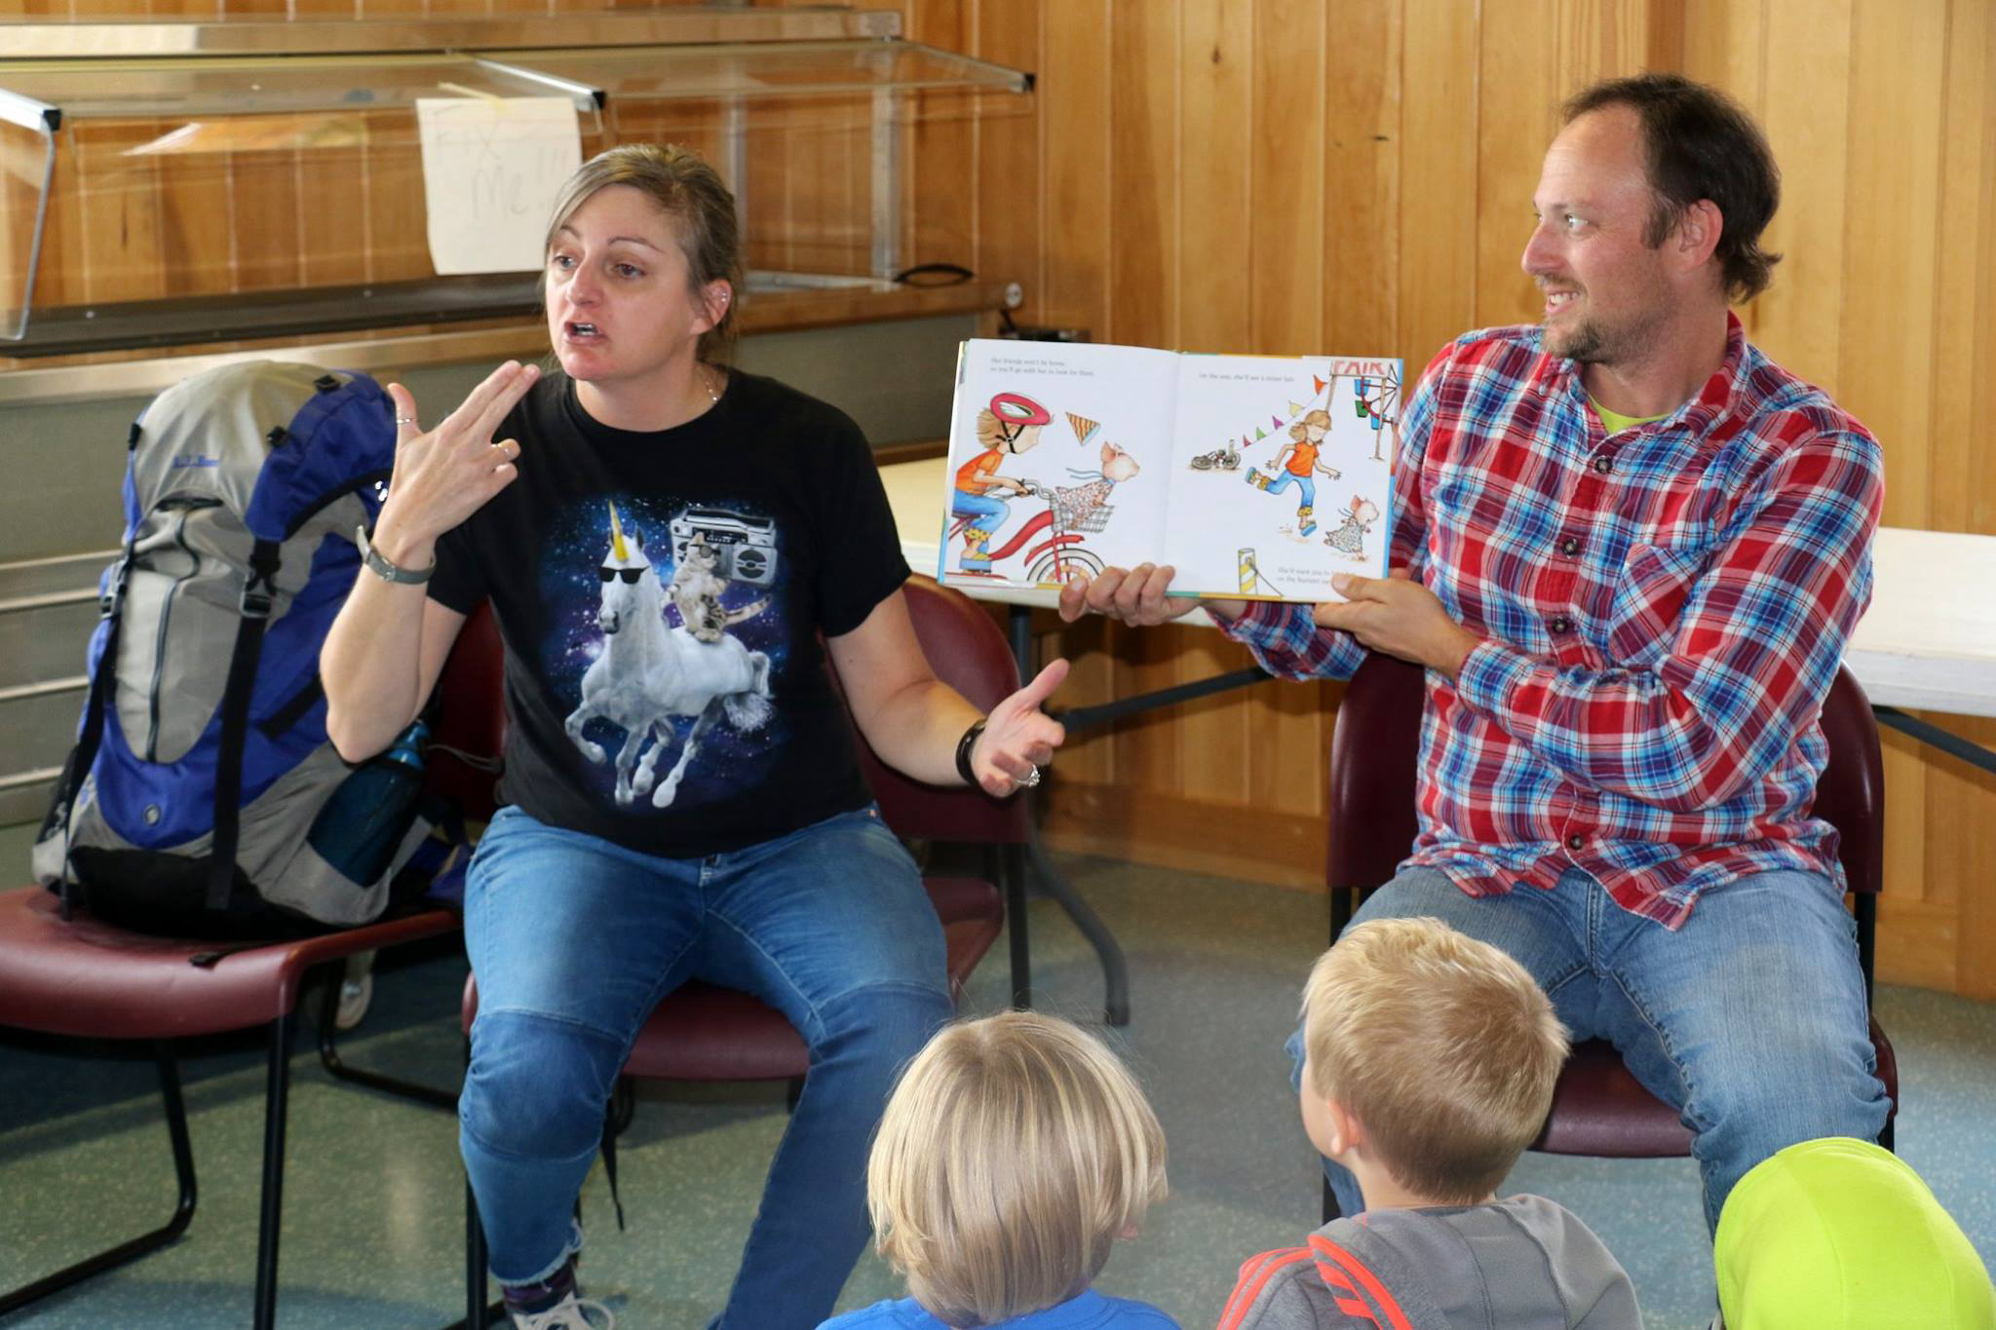
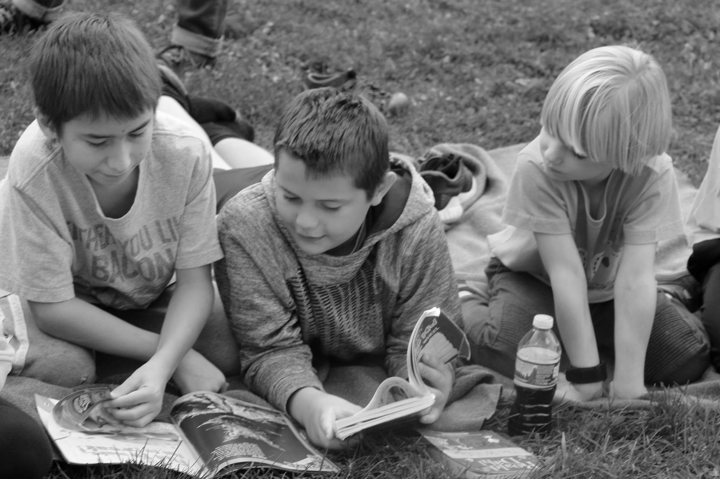
Literacy Block

Slide 20
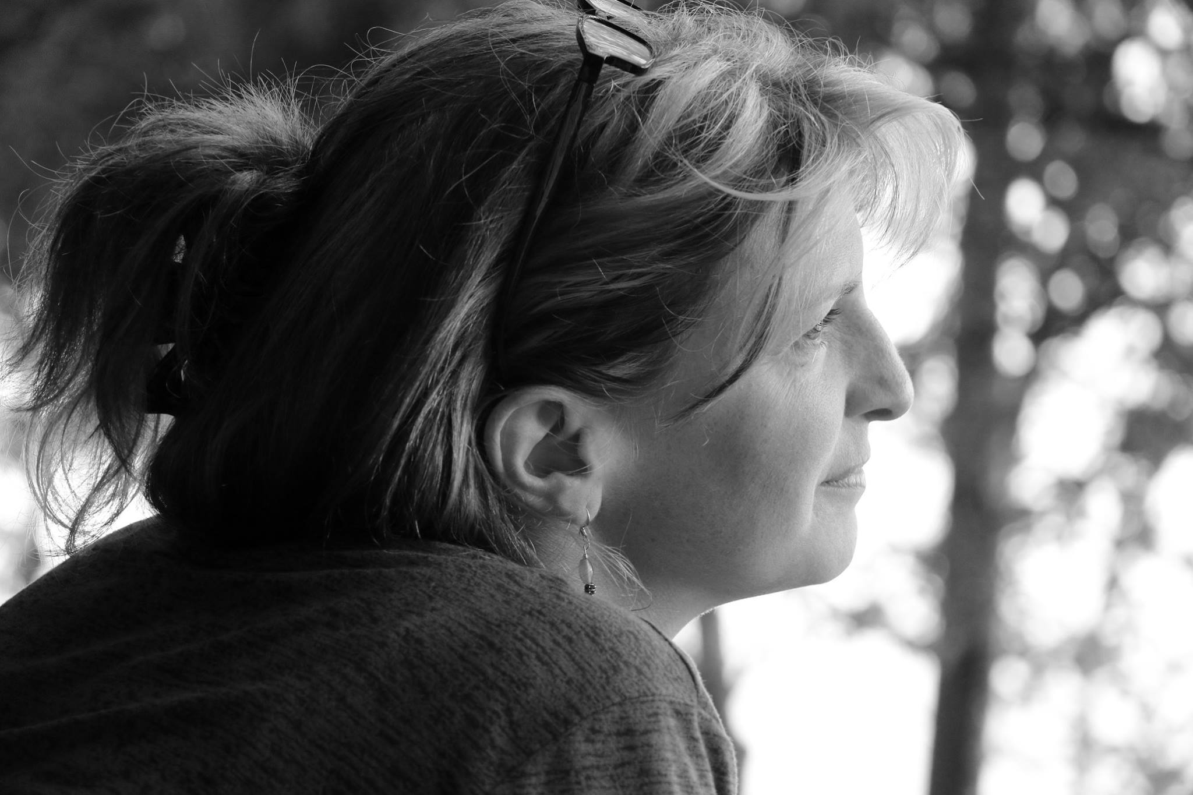
Parent Chat; parent-to-parent support

Slide 21
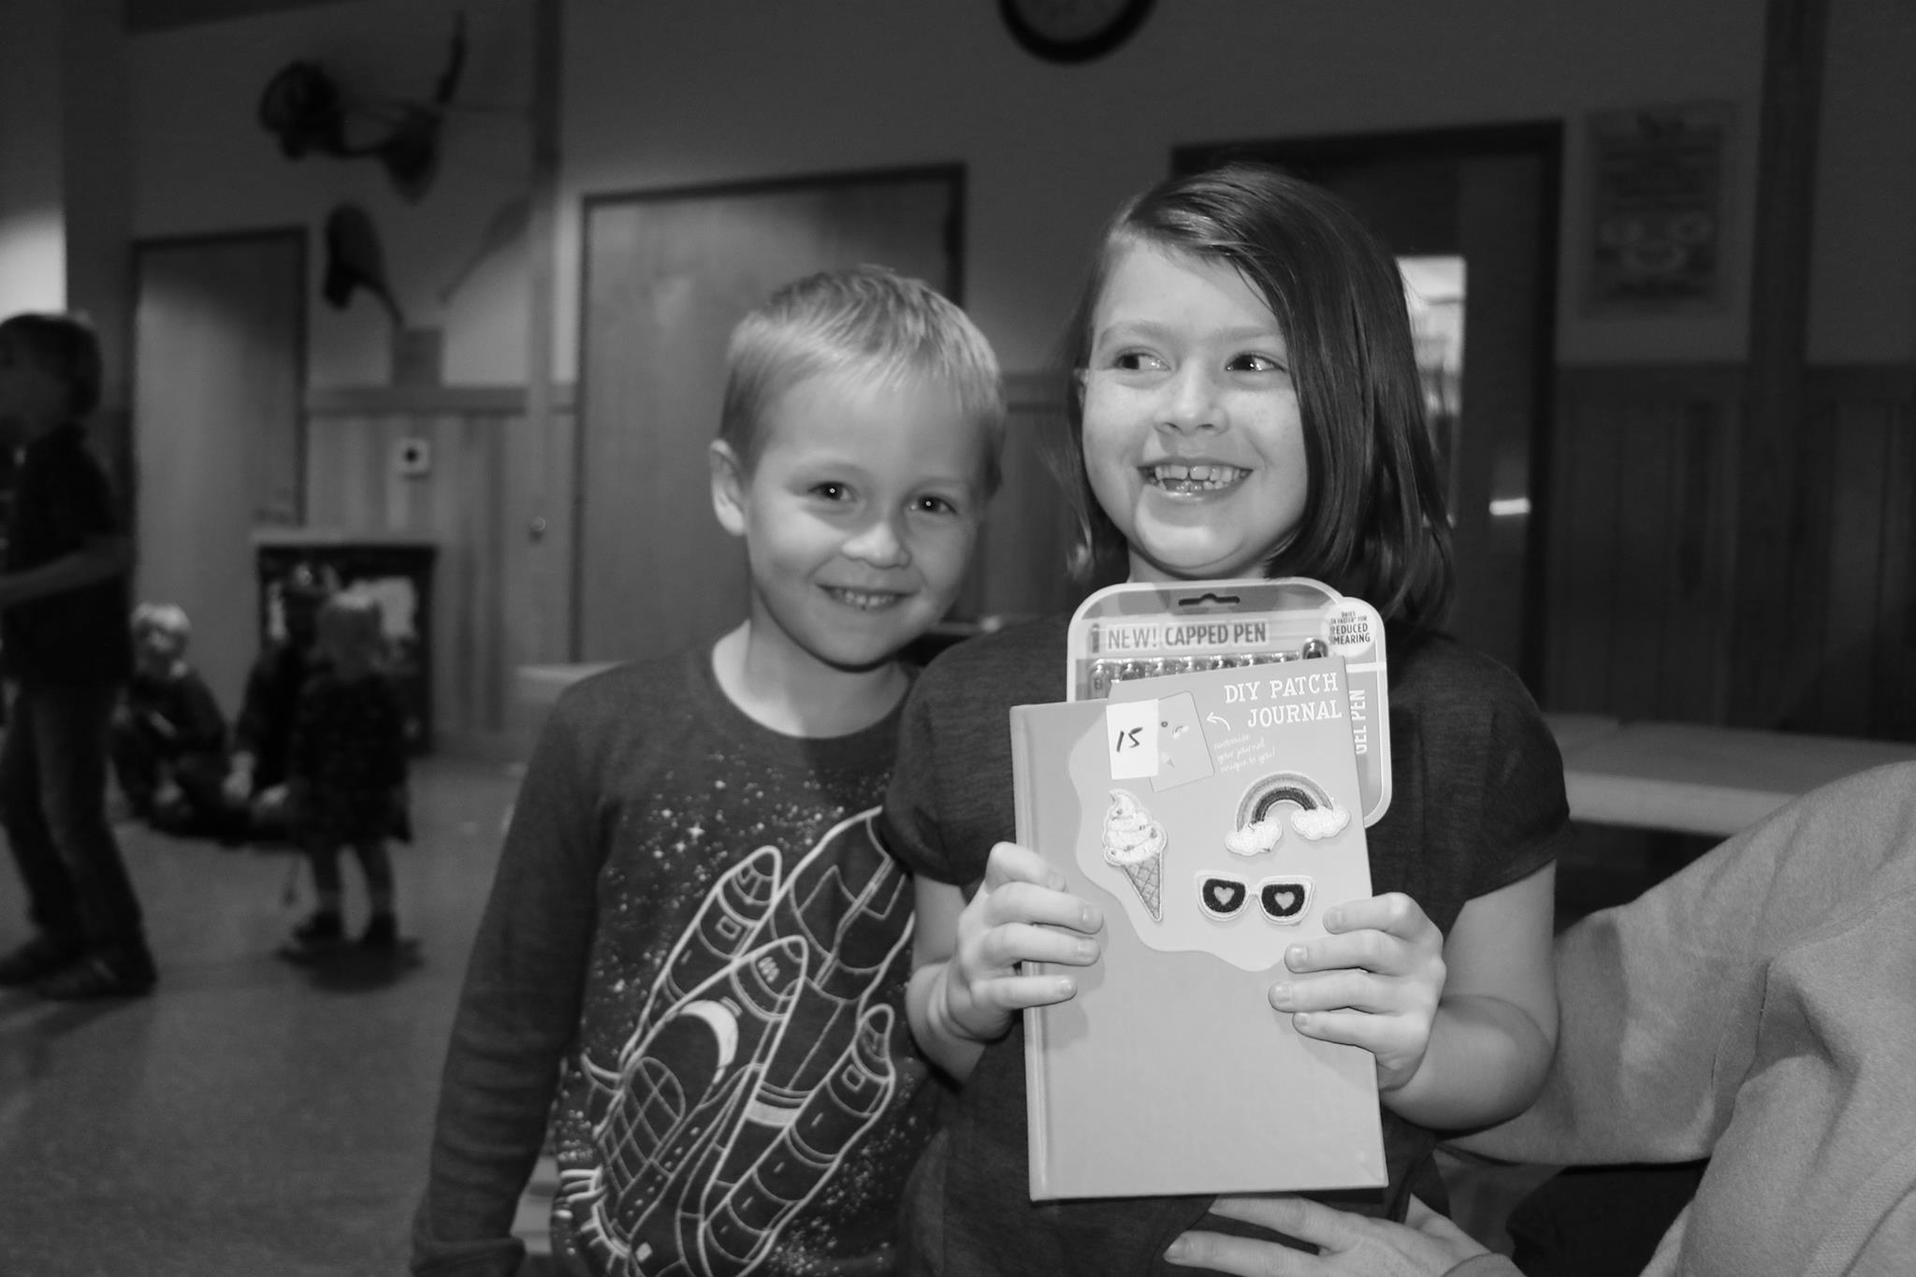
Silent Auction

Slide 22
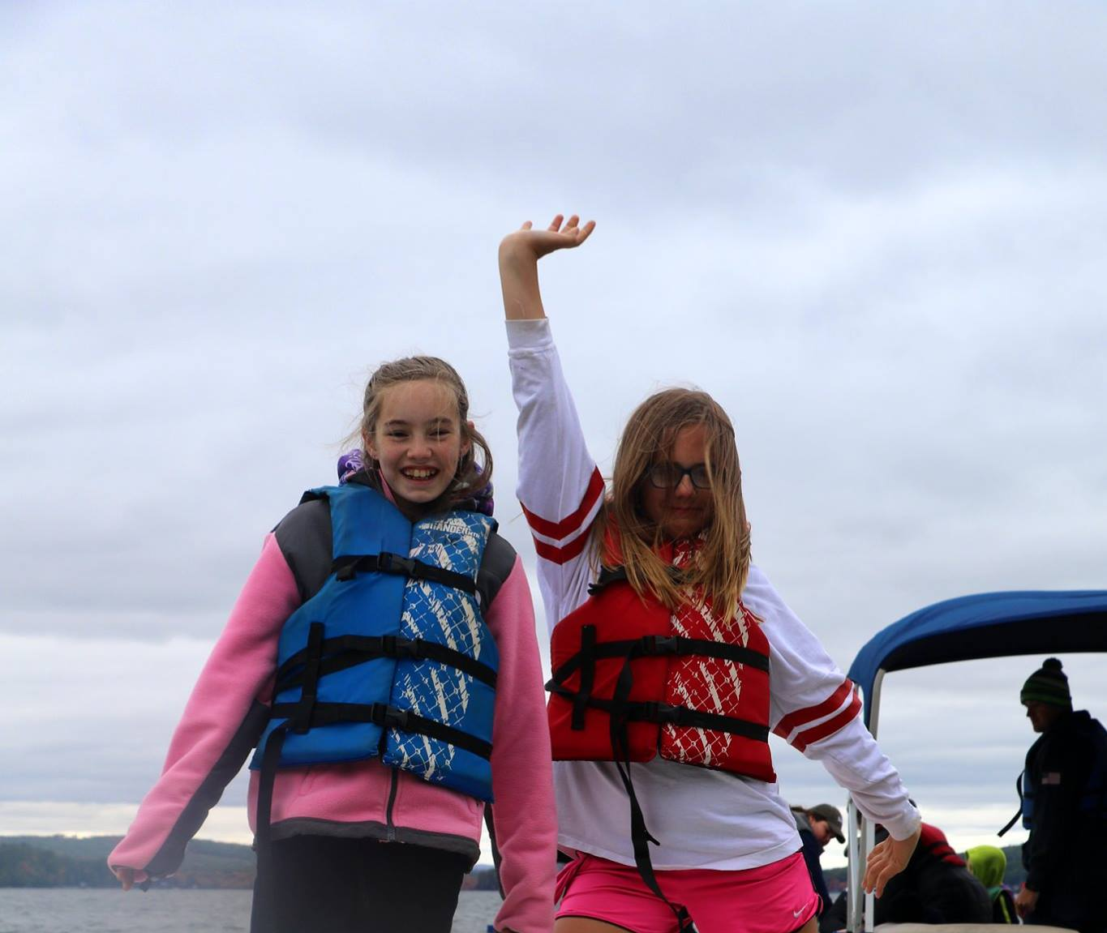
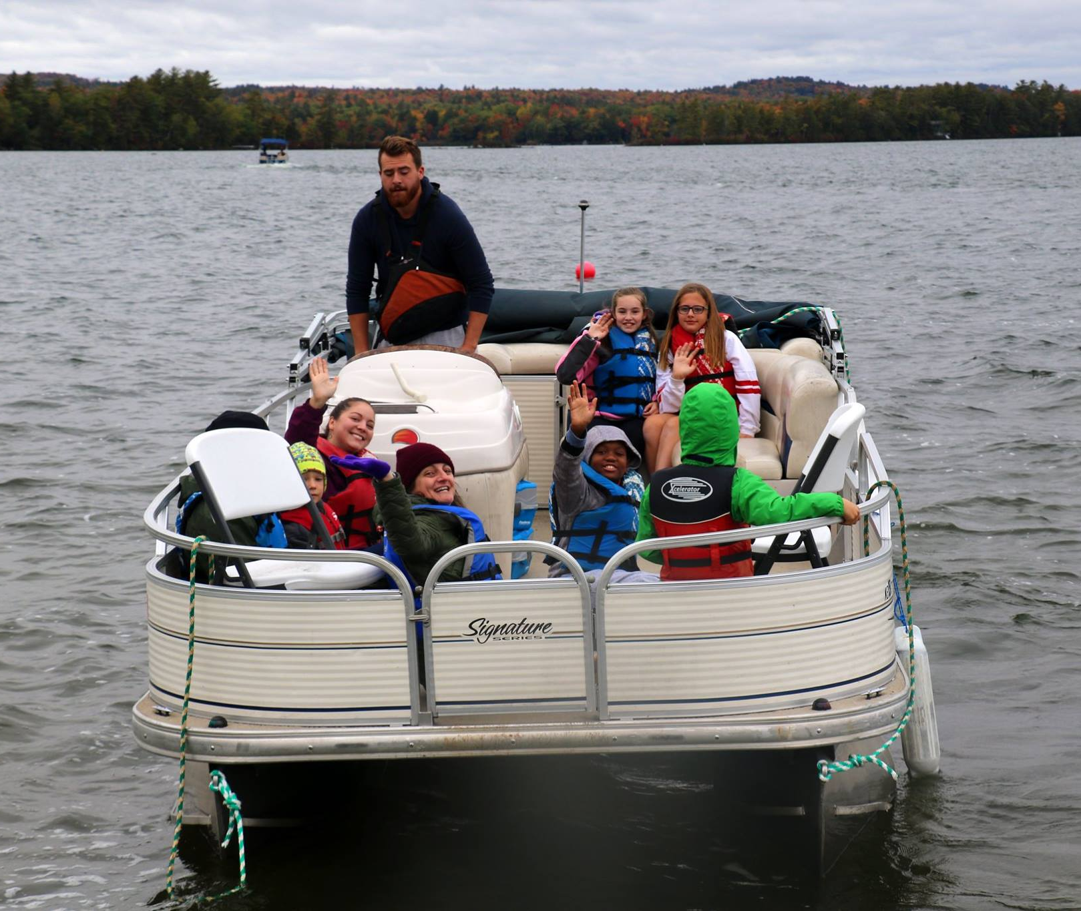
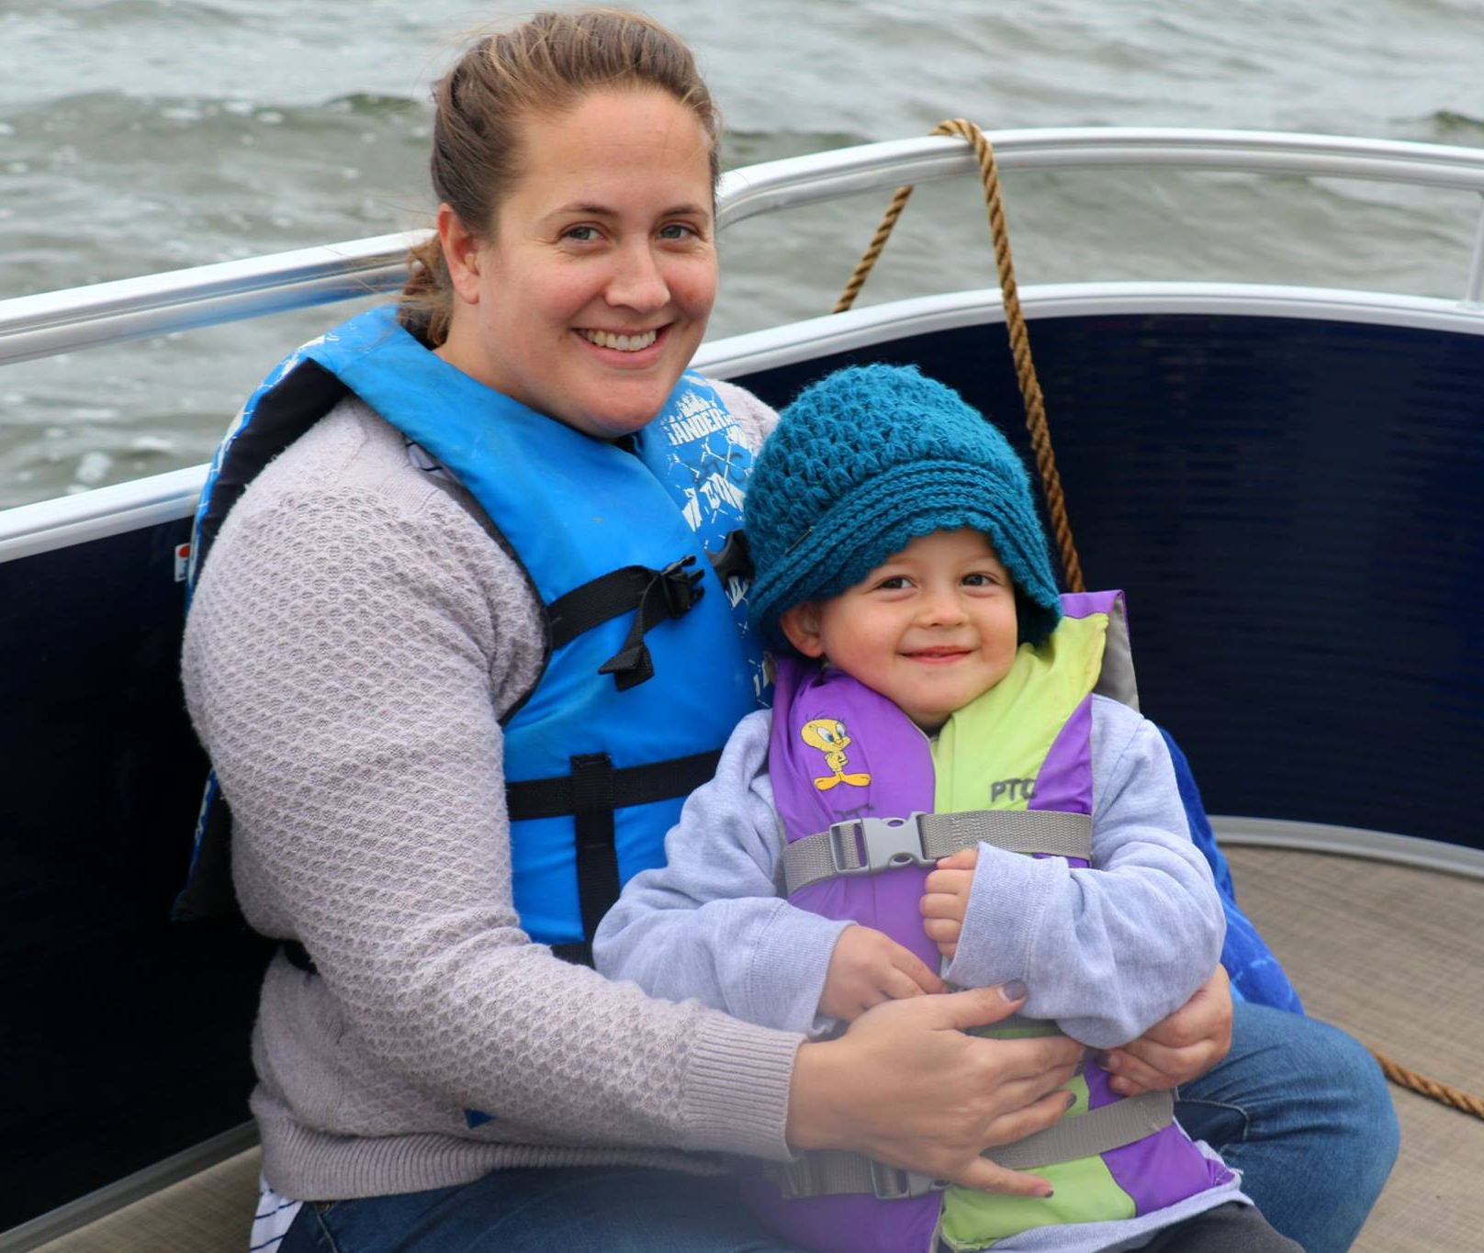
Boating

Slide 23
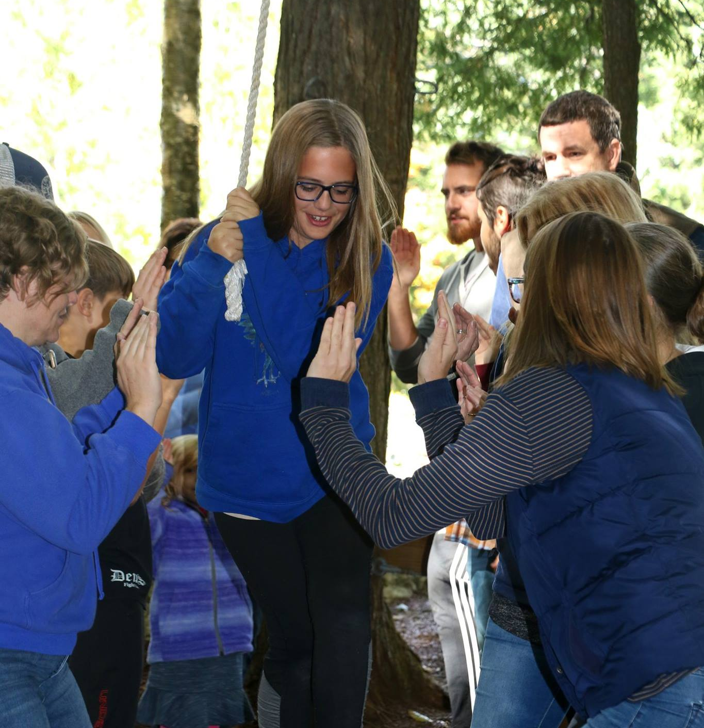
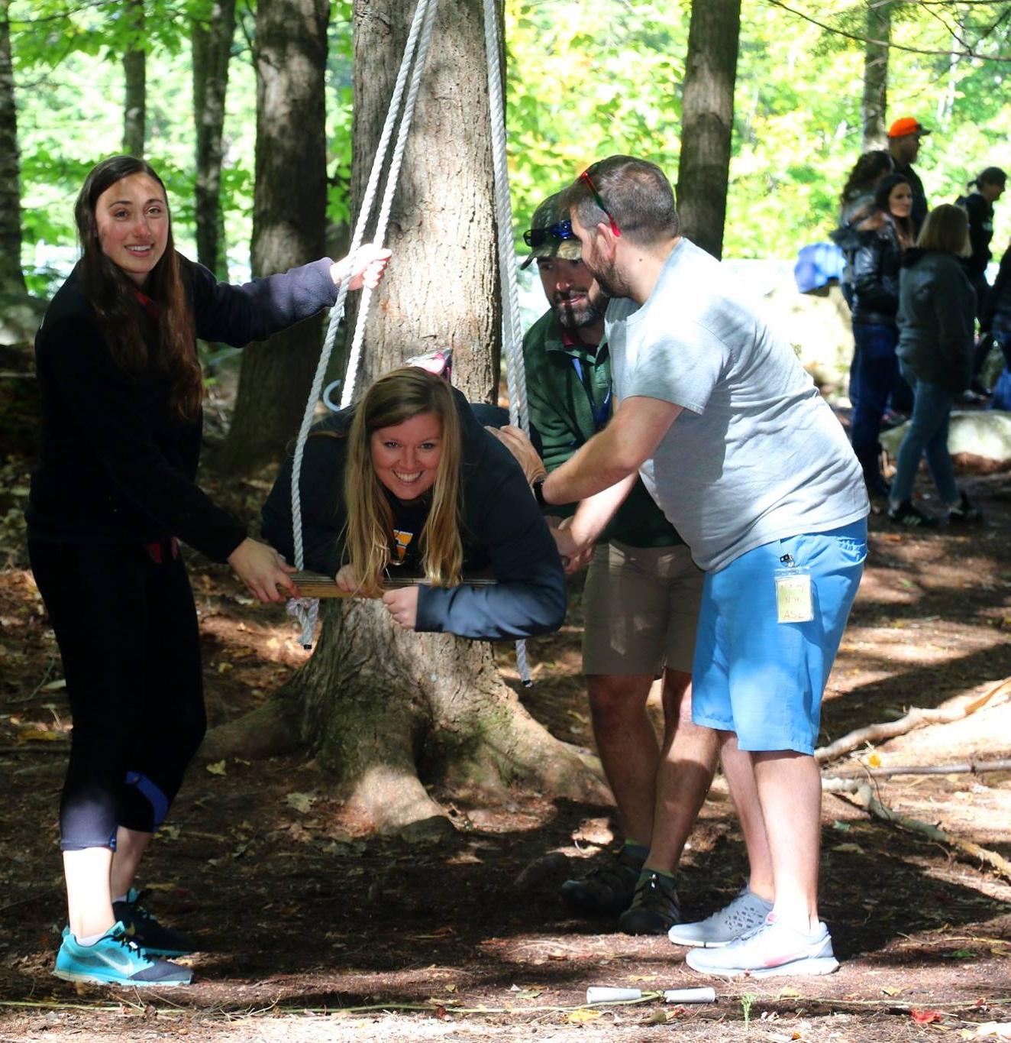
Ropes Course

Slide 24
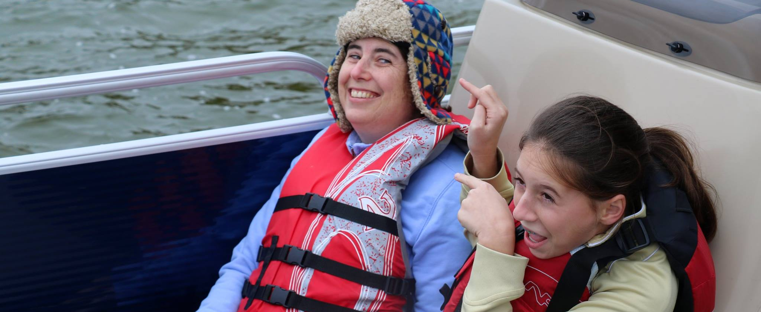
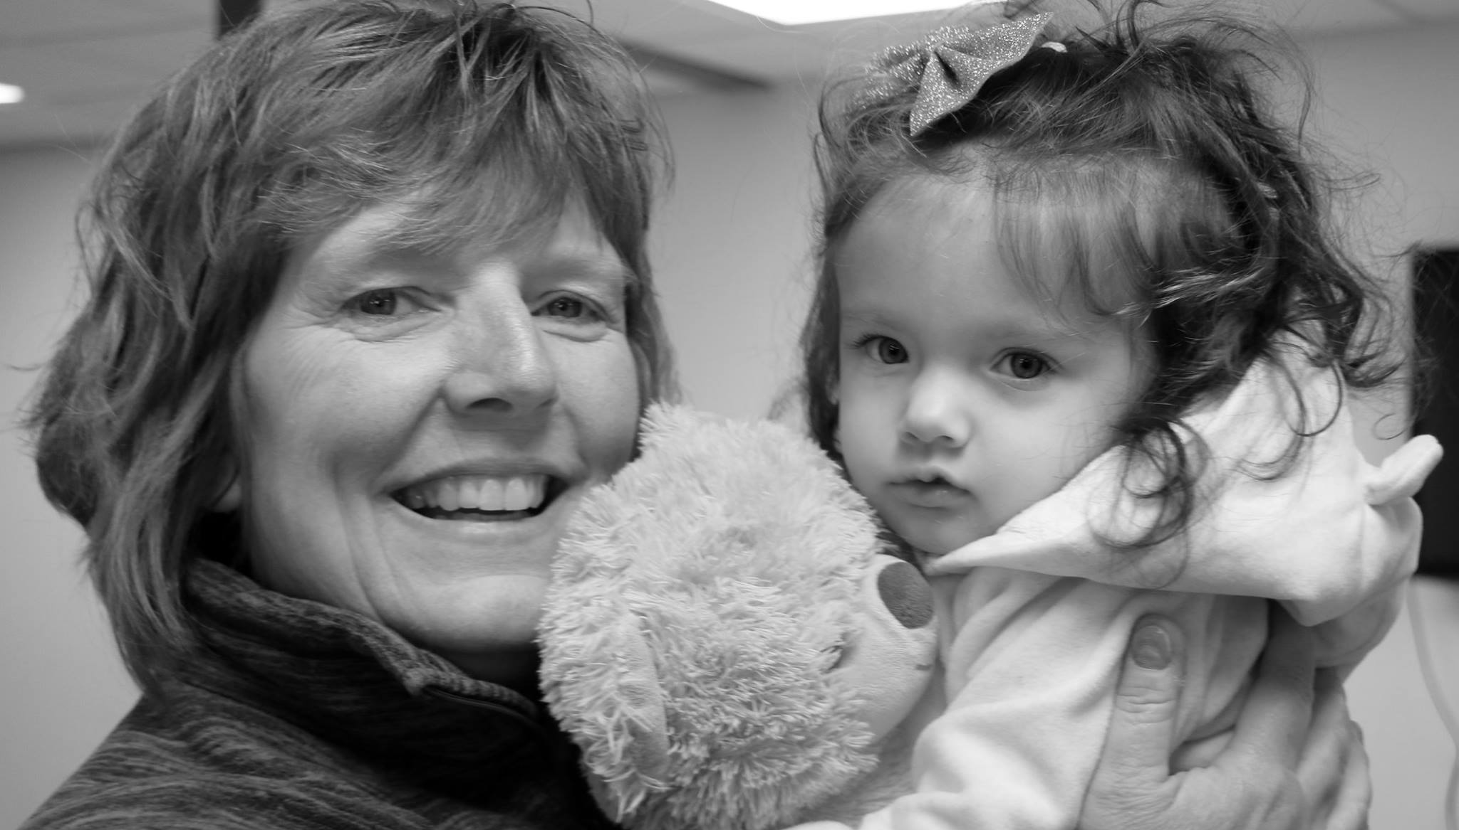
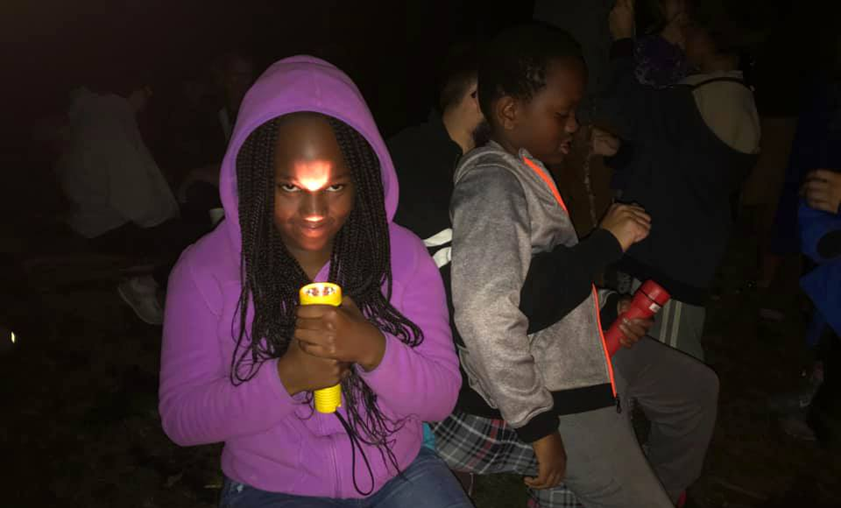
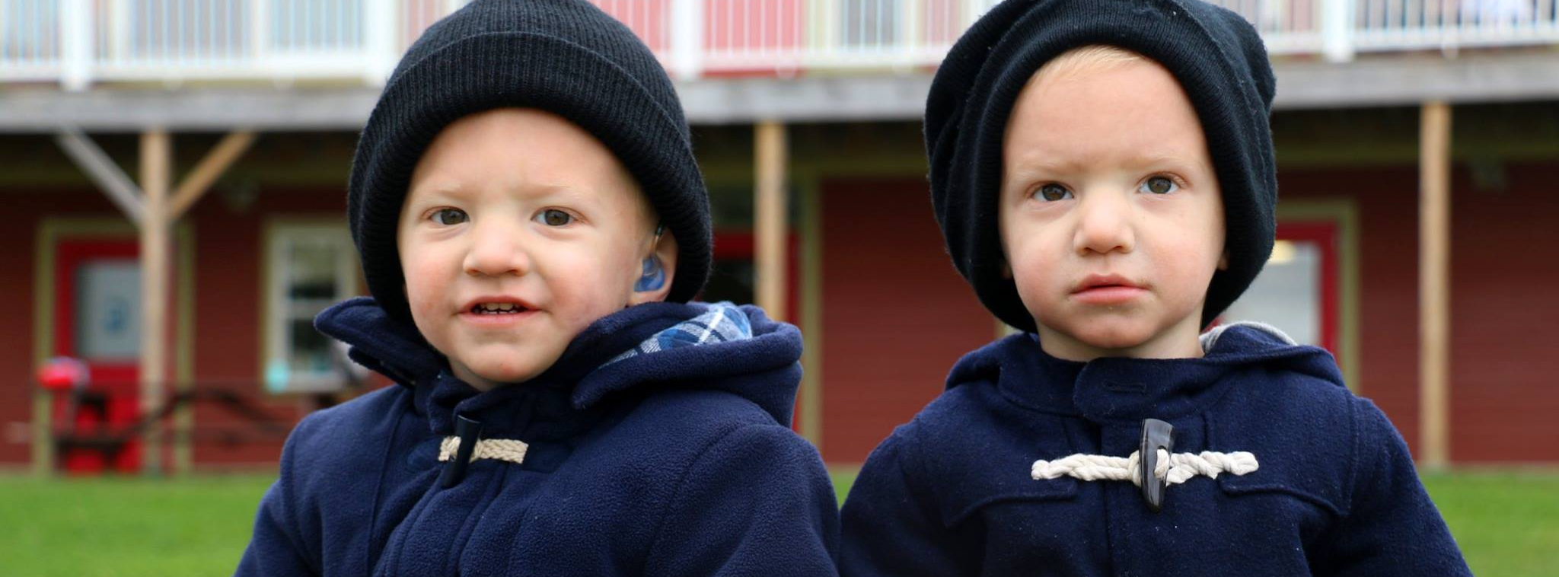

Slide 25
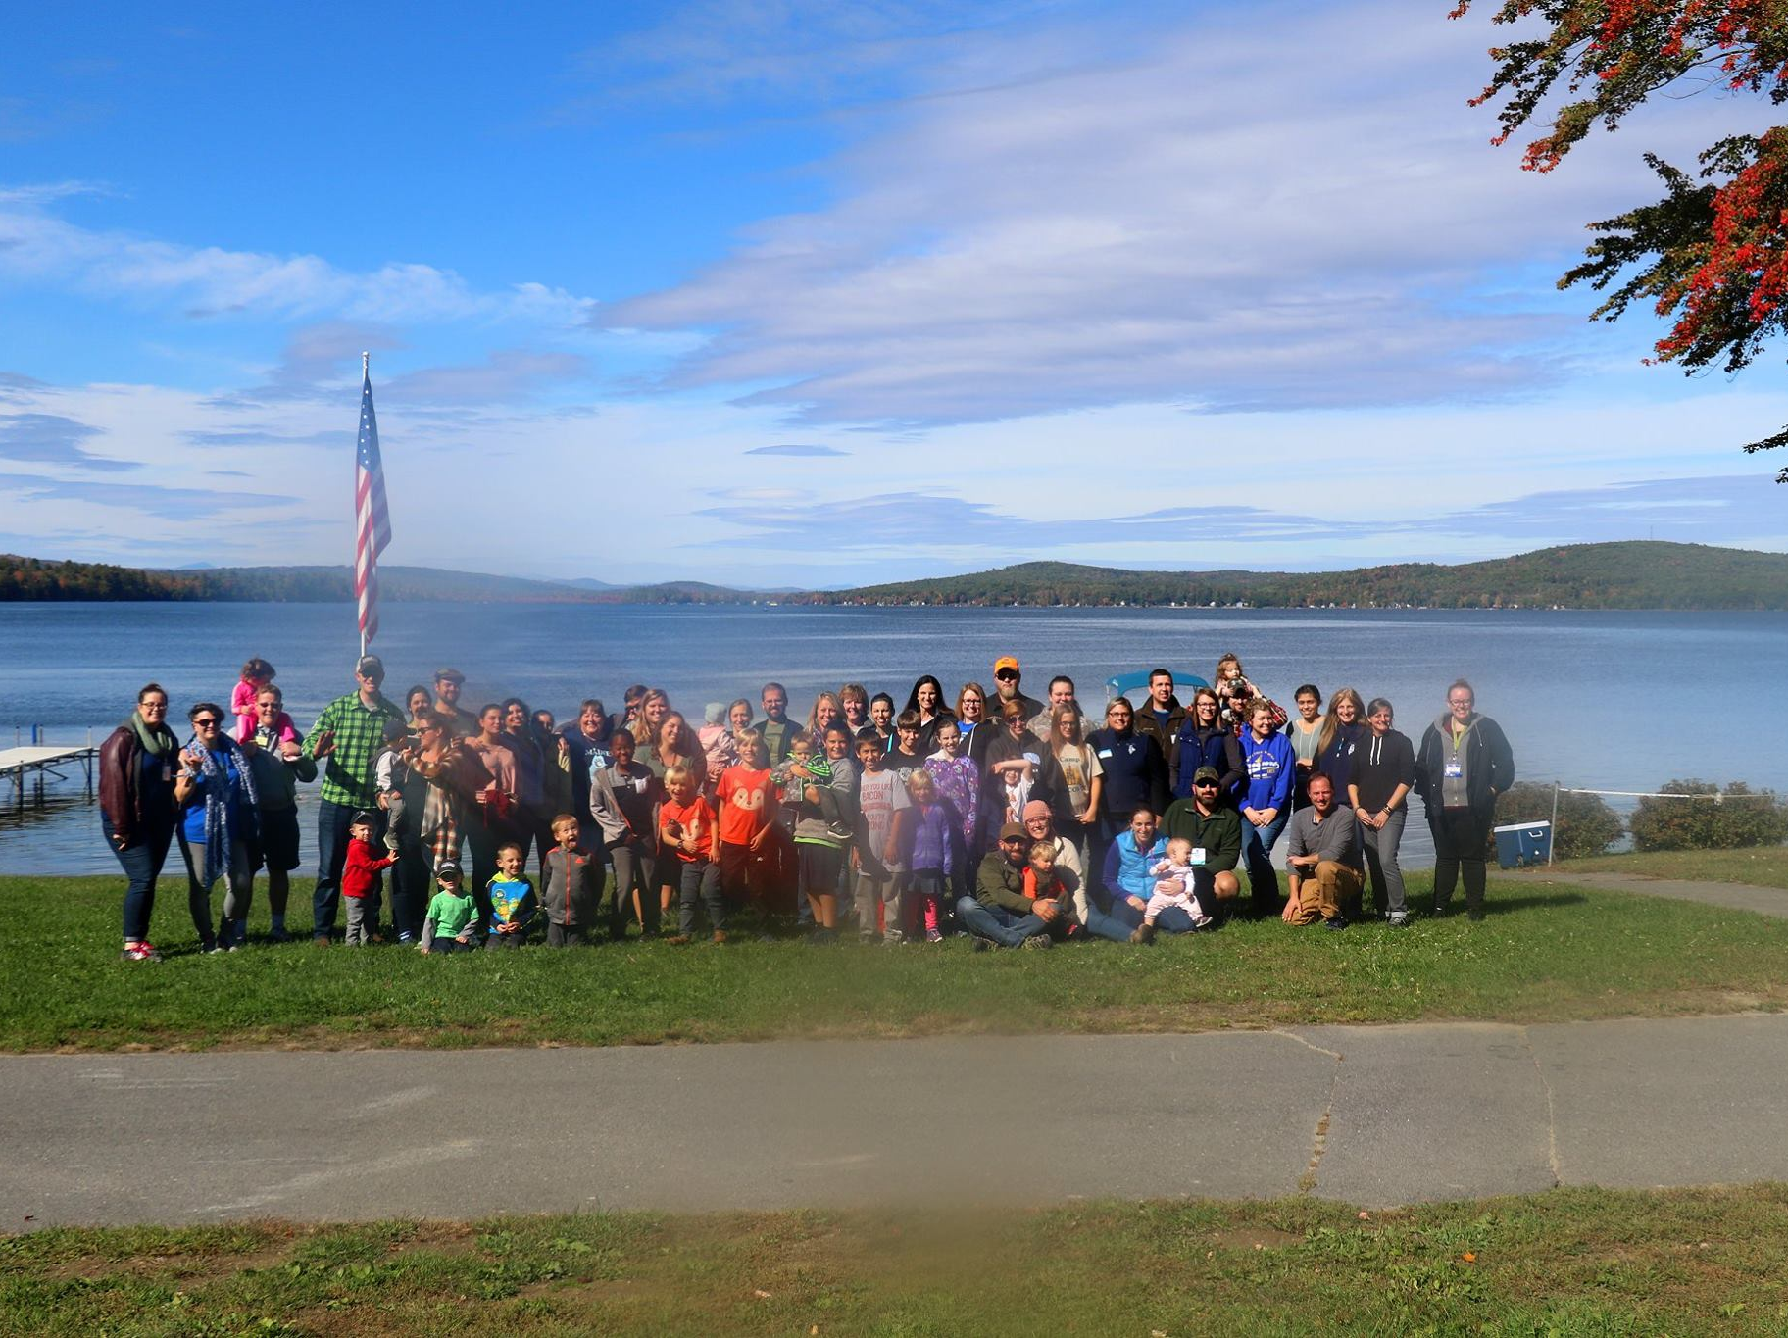
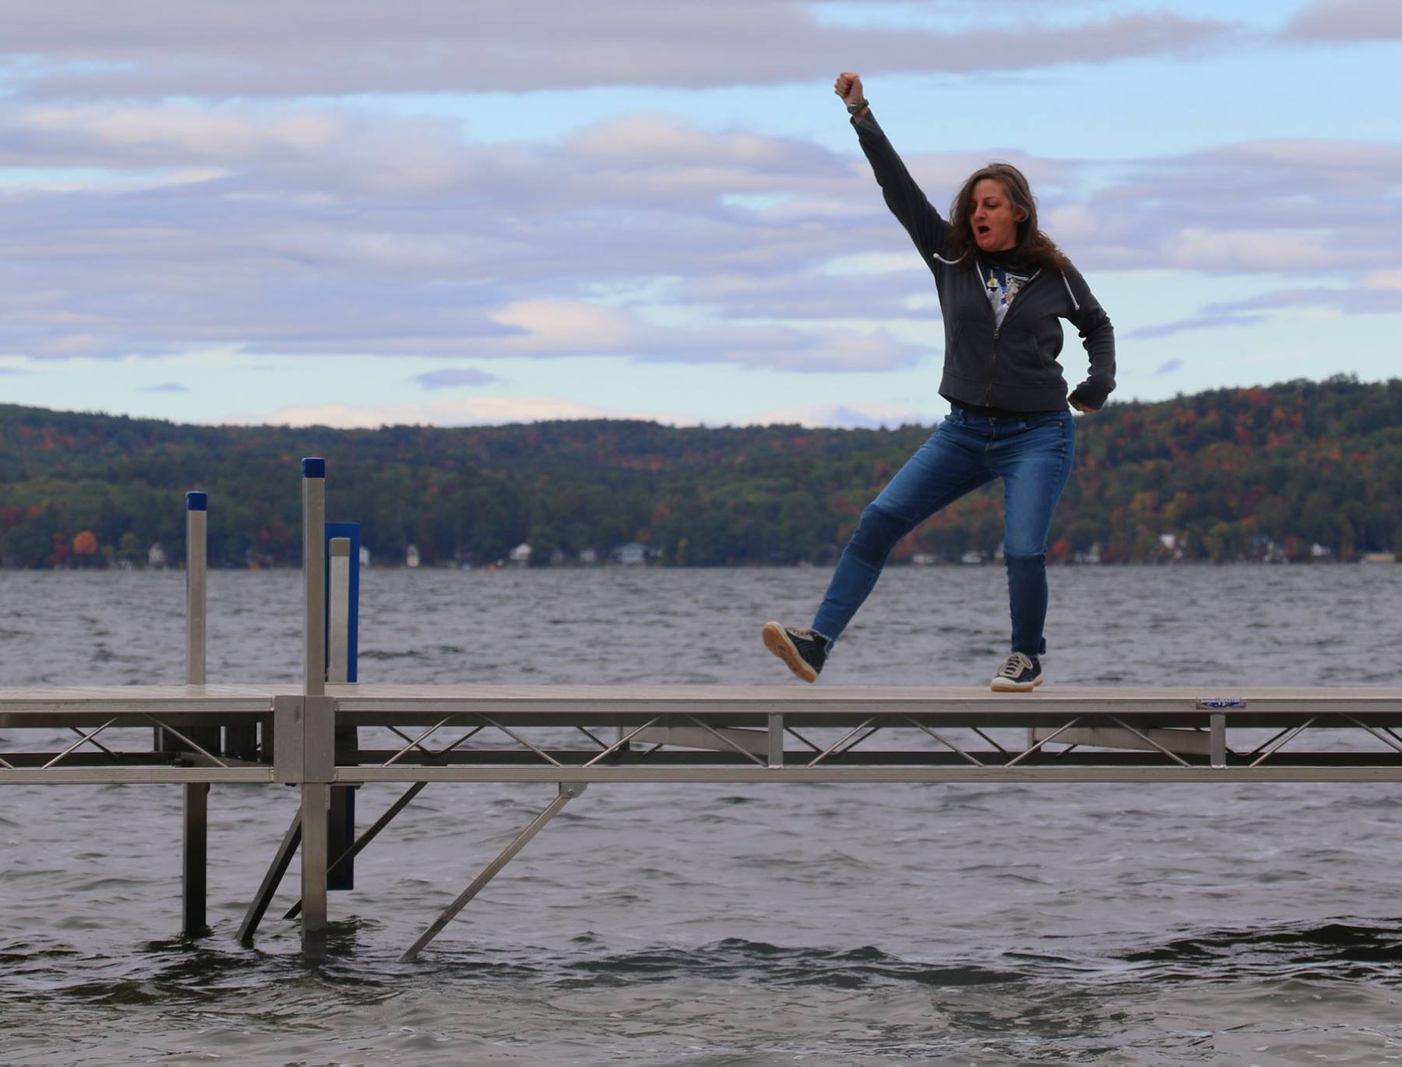

Slide 26
THANKS for visiting! ~Nicole Dobson, Camp Discover Director
Maine Hand & Voices,
The Cued Speech Association of Maine

